Slide 1
Hands-on NodeJS + JavaScript + Debug(WebStorm) + TypeScript
arnaud.nauwynck@gmail.com
Esilv 2023
This document: https://github.com/Arnaud-Nauwynck/presentations/tree/main/web/tp1-nodejs.pdf

Slide 2
Objectives
Discover NodeJs using practical « Hello World » developper code
Using Simple baby steps, step by step
Setup your web environment
Become familiar with the Web FrontEnd ecosystem

Slide 3
Outline
Download + Install NodeJs
Run NodeJS from the command line
Discover and run basic javascript program
Discover NPM Node Package Manager
Install package.json dependencies
Install WebStorm IDE (students may choose any IDE, VisualStudio Code)
Debug Javascript program
TypeScript to JavaScript from the IDE
Tsc compiler
Debug TypeScript

Slide 4
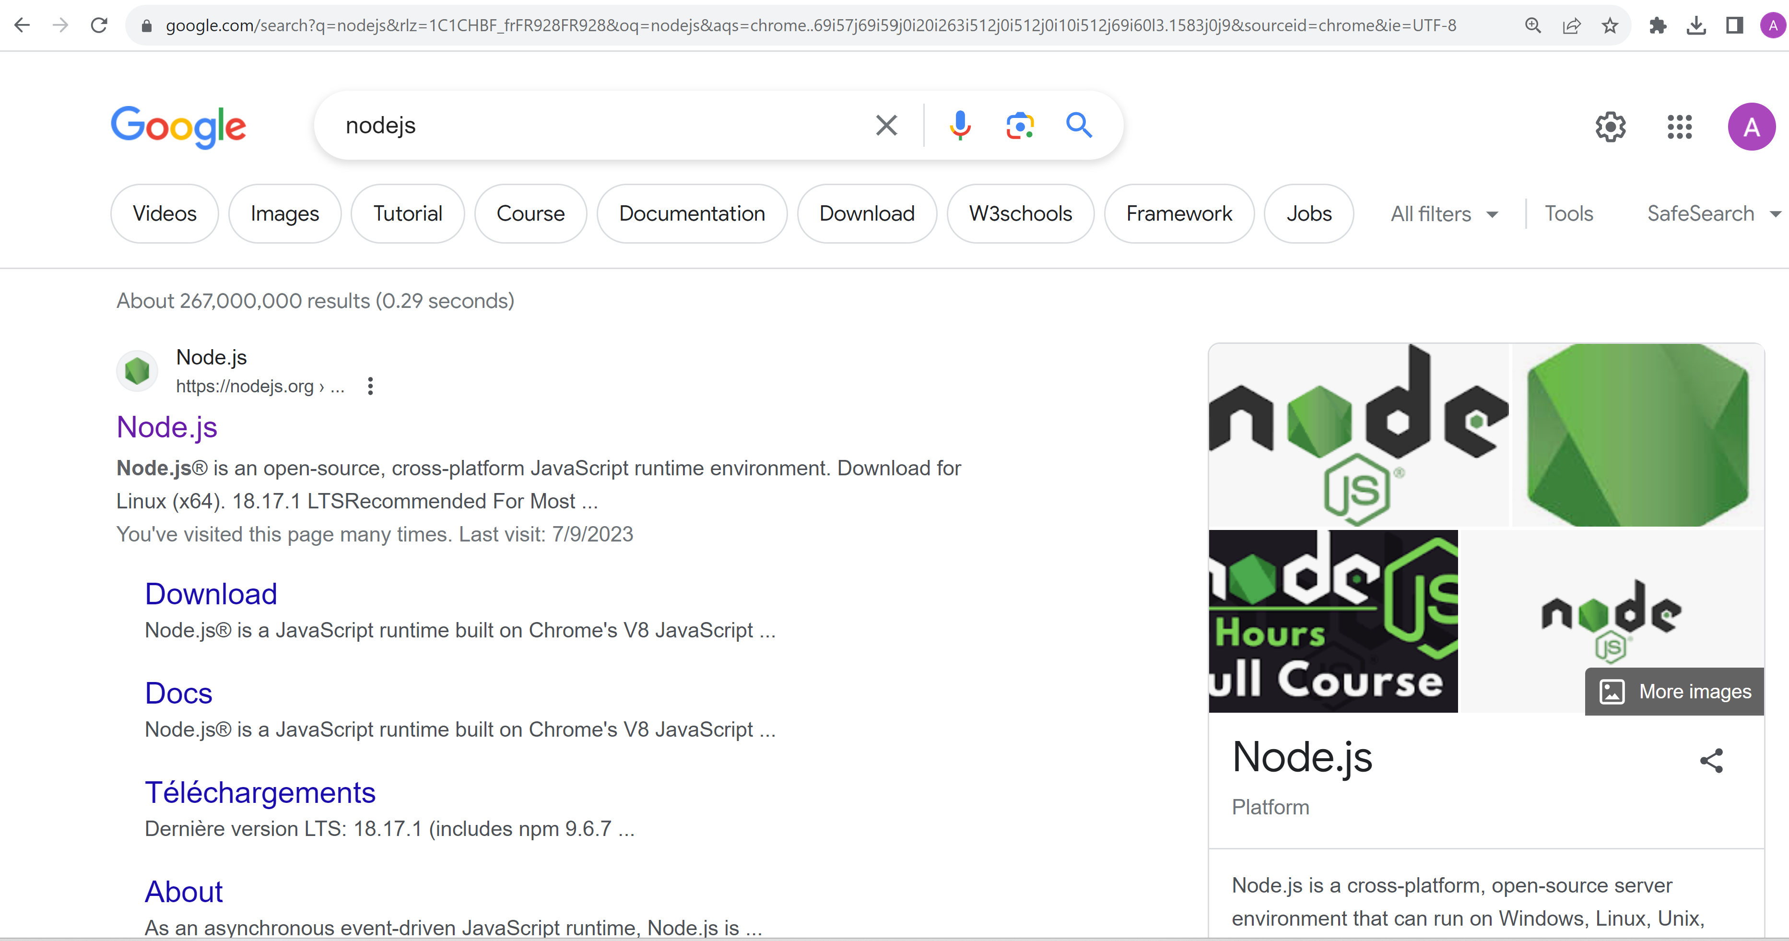
Google NodeJs

Slide 5
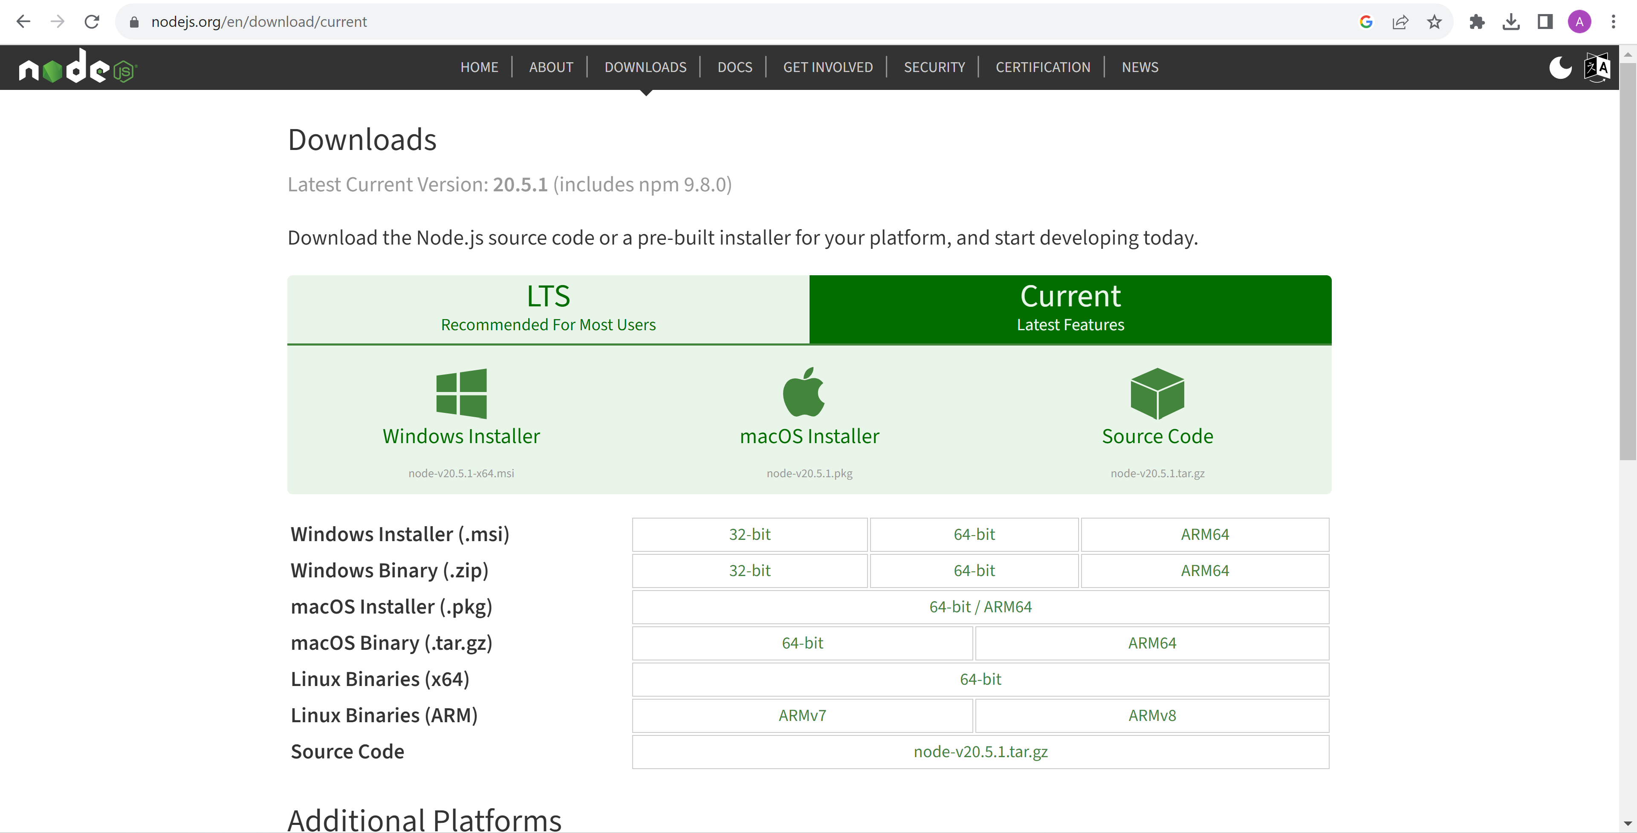
Download NodeJs

Slide 6
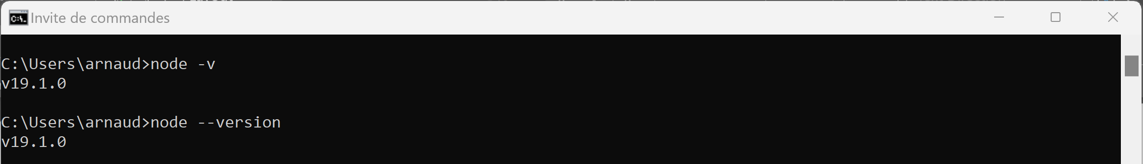
Check NodeJs exe (check version) C:> node -v

Slide 7
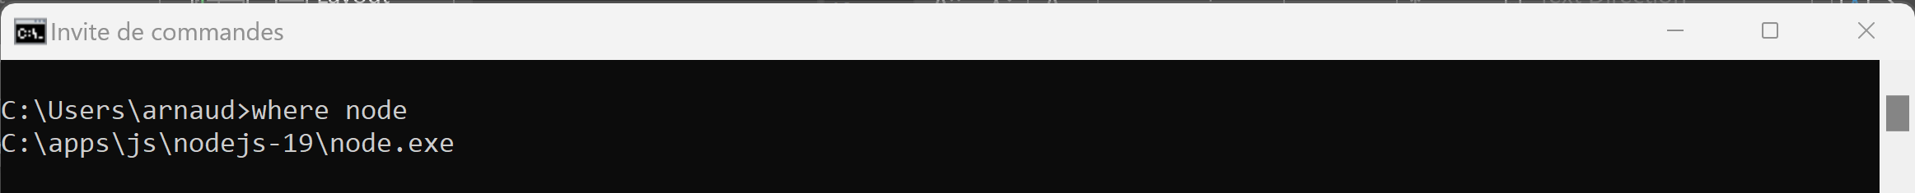
Several installed ? … which one will be resolved C:> where node

Slide 8
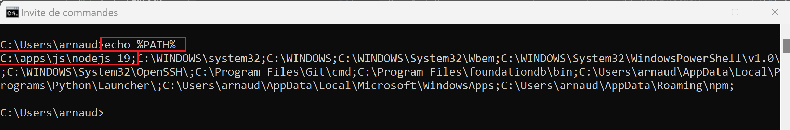
Check NodeJS is in « %PATH% »(win cmd terminal) echo %PATH%

Slide 9
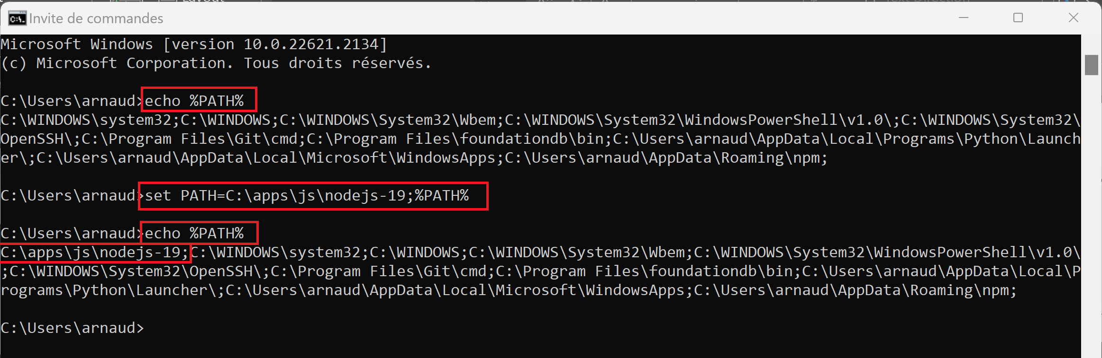
If missing … change to add in « %PATH% » ( may call setenv.cmd, or edit System Variables… AND restart cmd terminal) set PATH=c:\your-node-dir;%PATH%

Slide 10
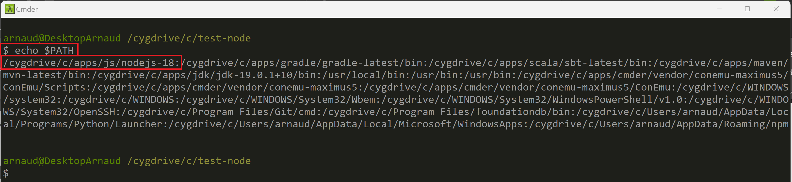
Case 2… using Cmder > Bash$ Check NodeJS « $PATH » echo $PATH

Slide 11
Case 2 … using Cmder Bash, Adding in $PATH export PATH=/c/your-node-dir:$PATH

Slide 12
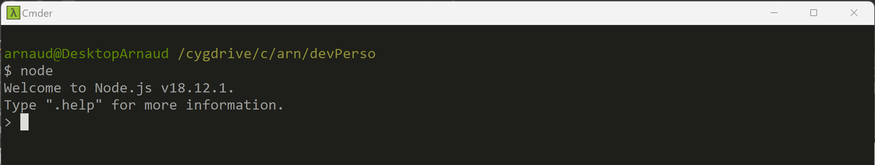
Start NodeJs interactive prompt C:> node

Slide 13
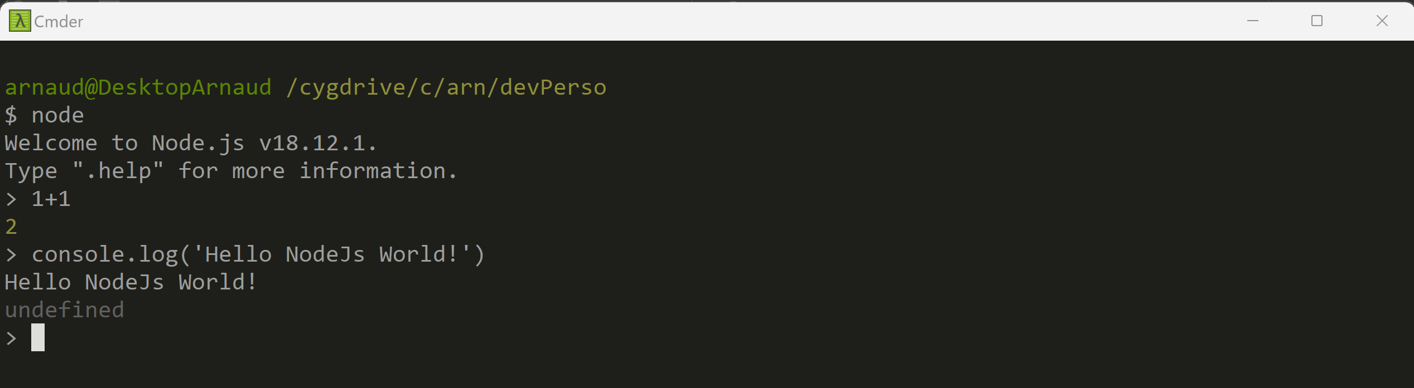
Play with interactive Javascript eval 1+1 console.log(‘Hello’)

Slide 14
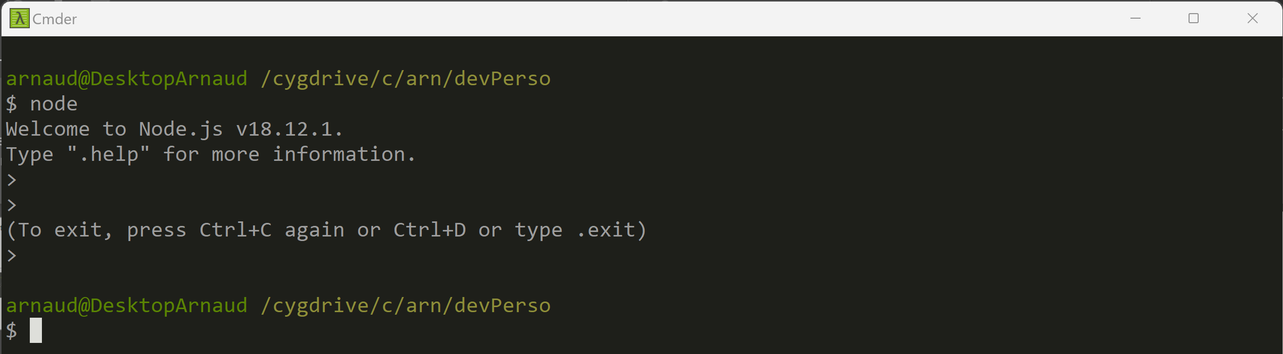
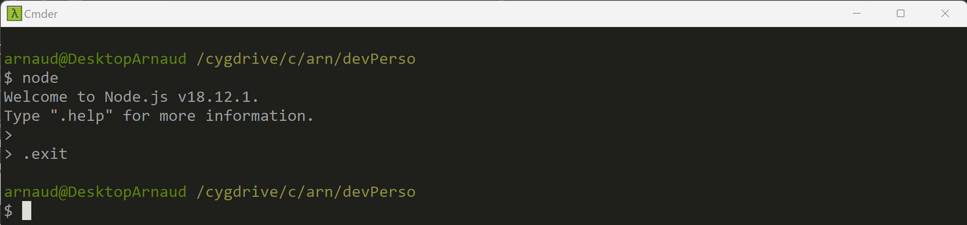
Stop Prompt … Ctrl+C Ctrl+C or .exit

Slide 15
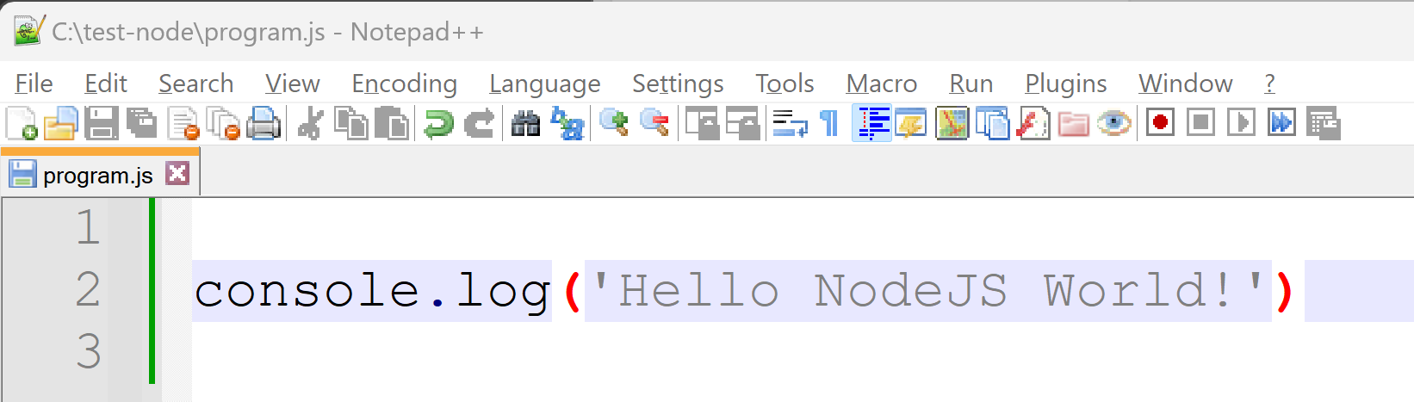
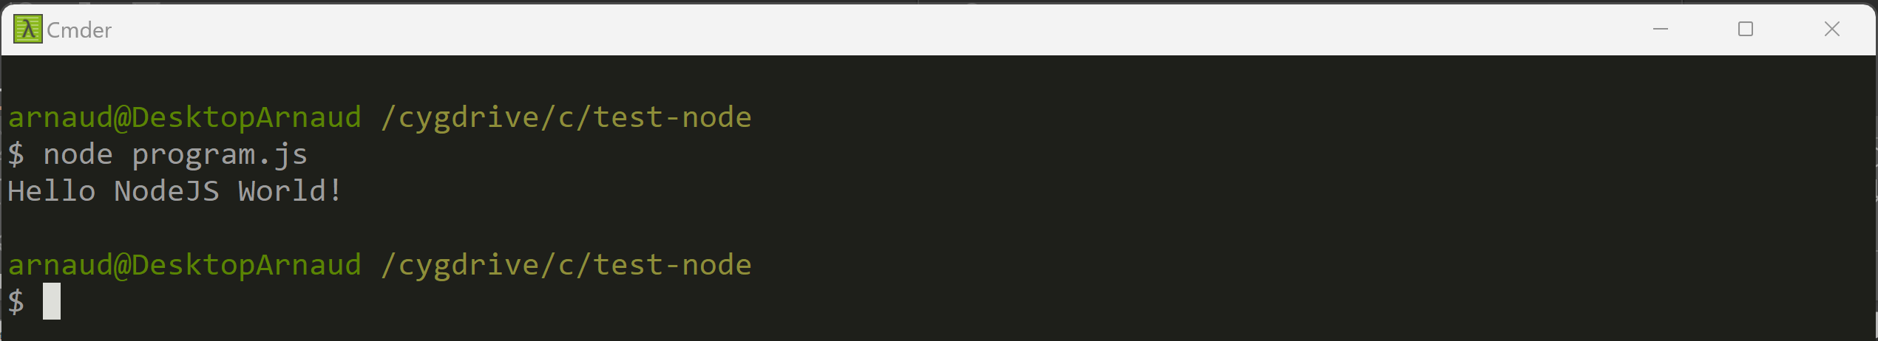
Start NodeJs on a « program.js » file C:> node program.js

Slide 16
Coffee Break (?)

Slide 17
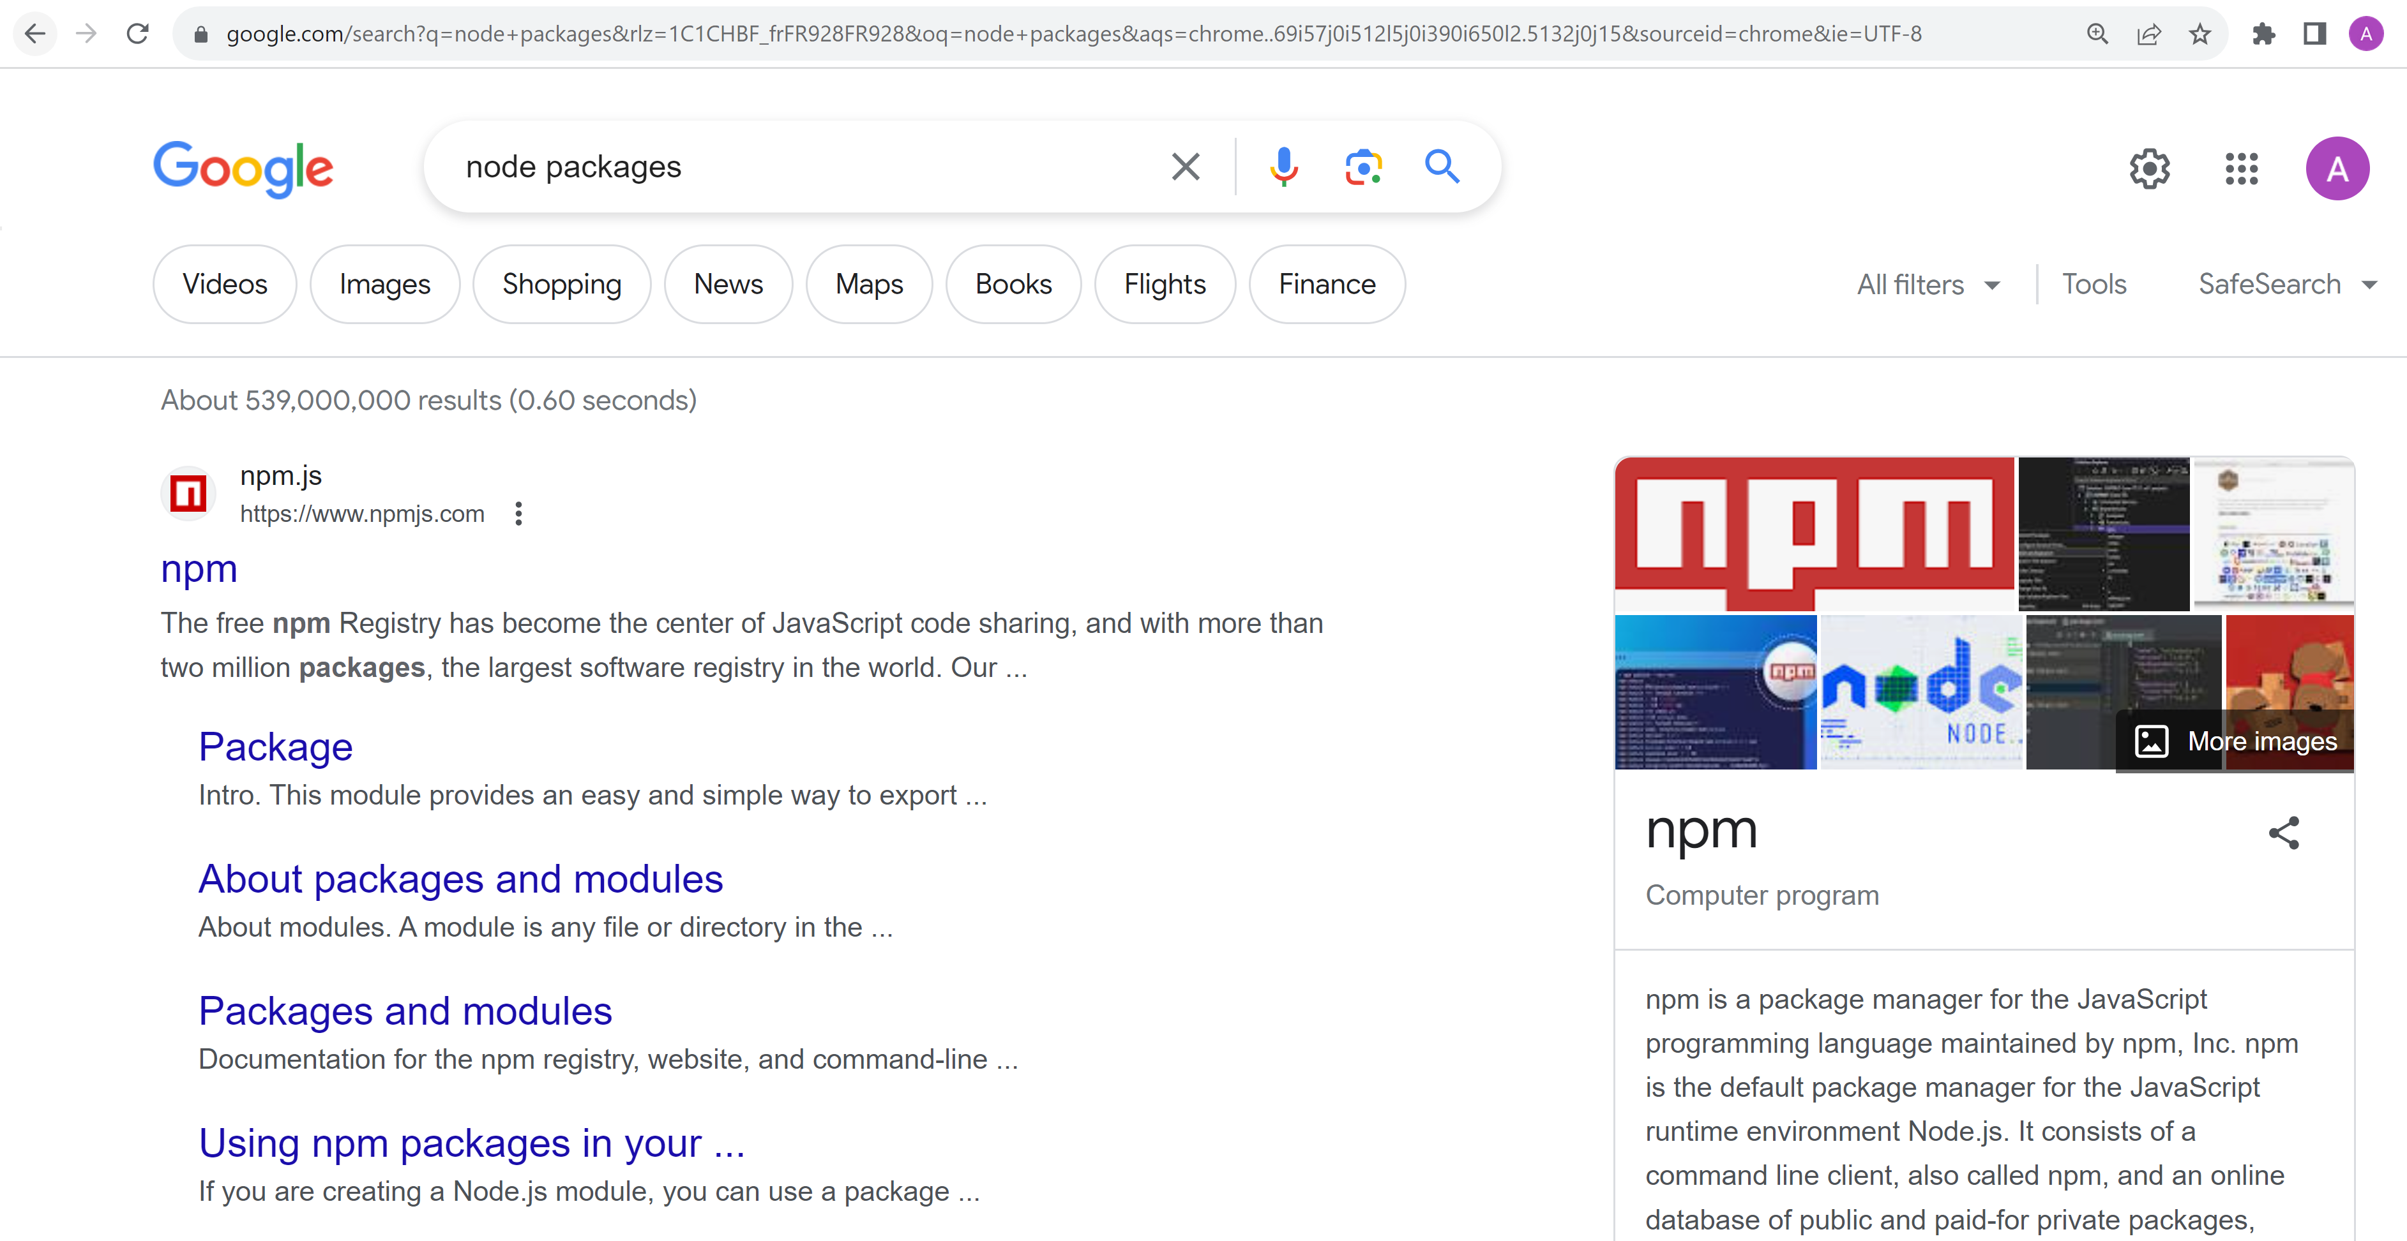
Node … need Package !!! Npm = Node Package Manager

Slide 18
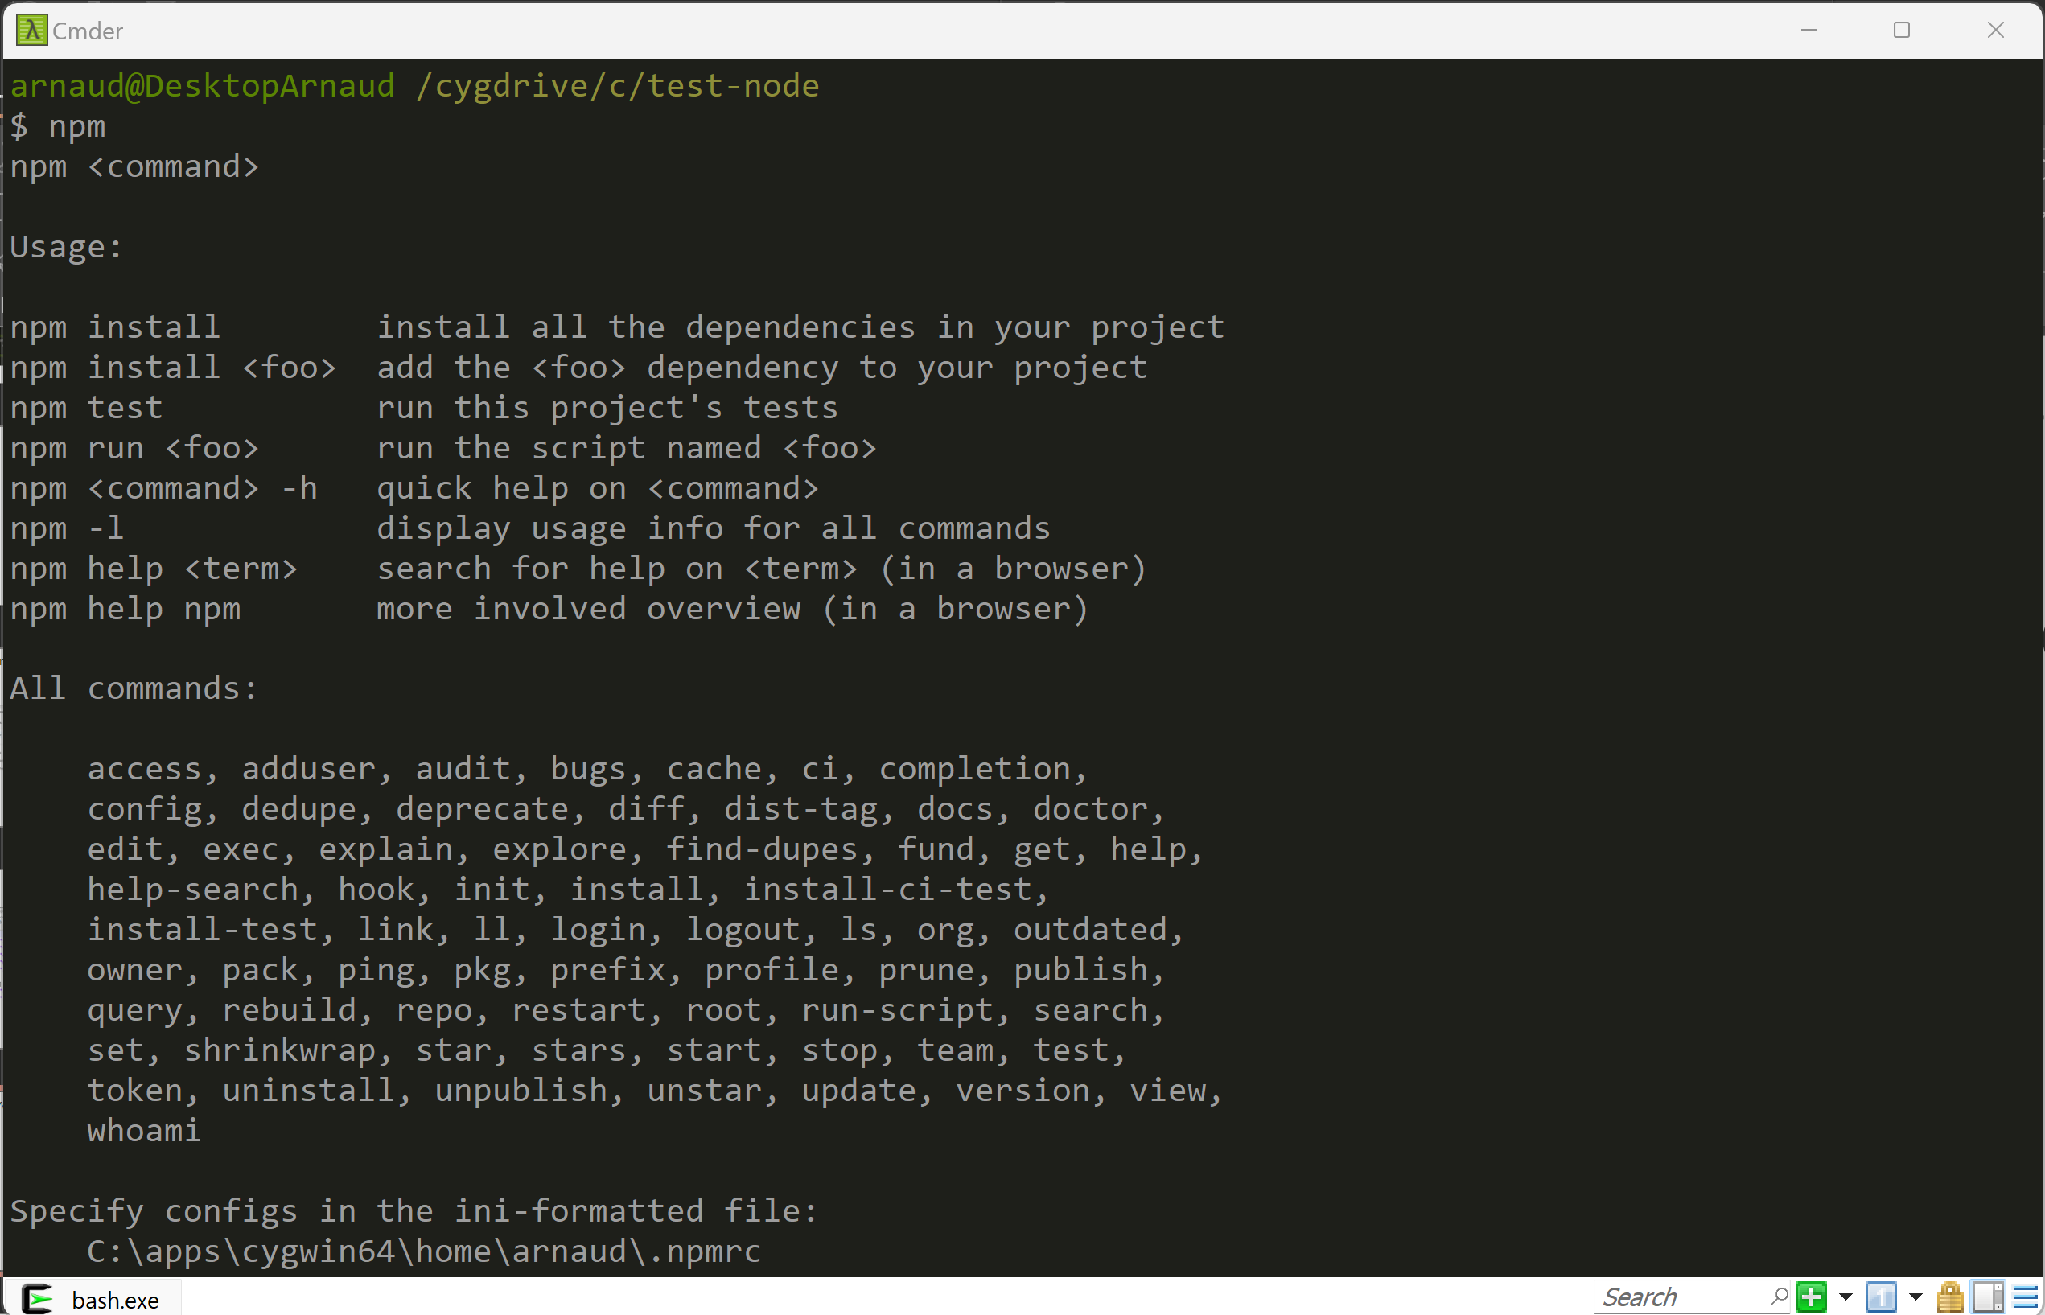
C:> npm

Slide 19
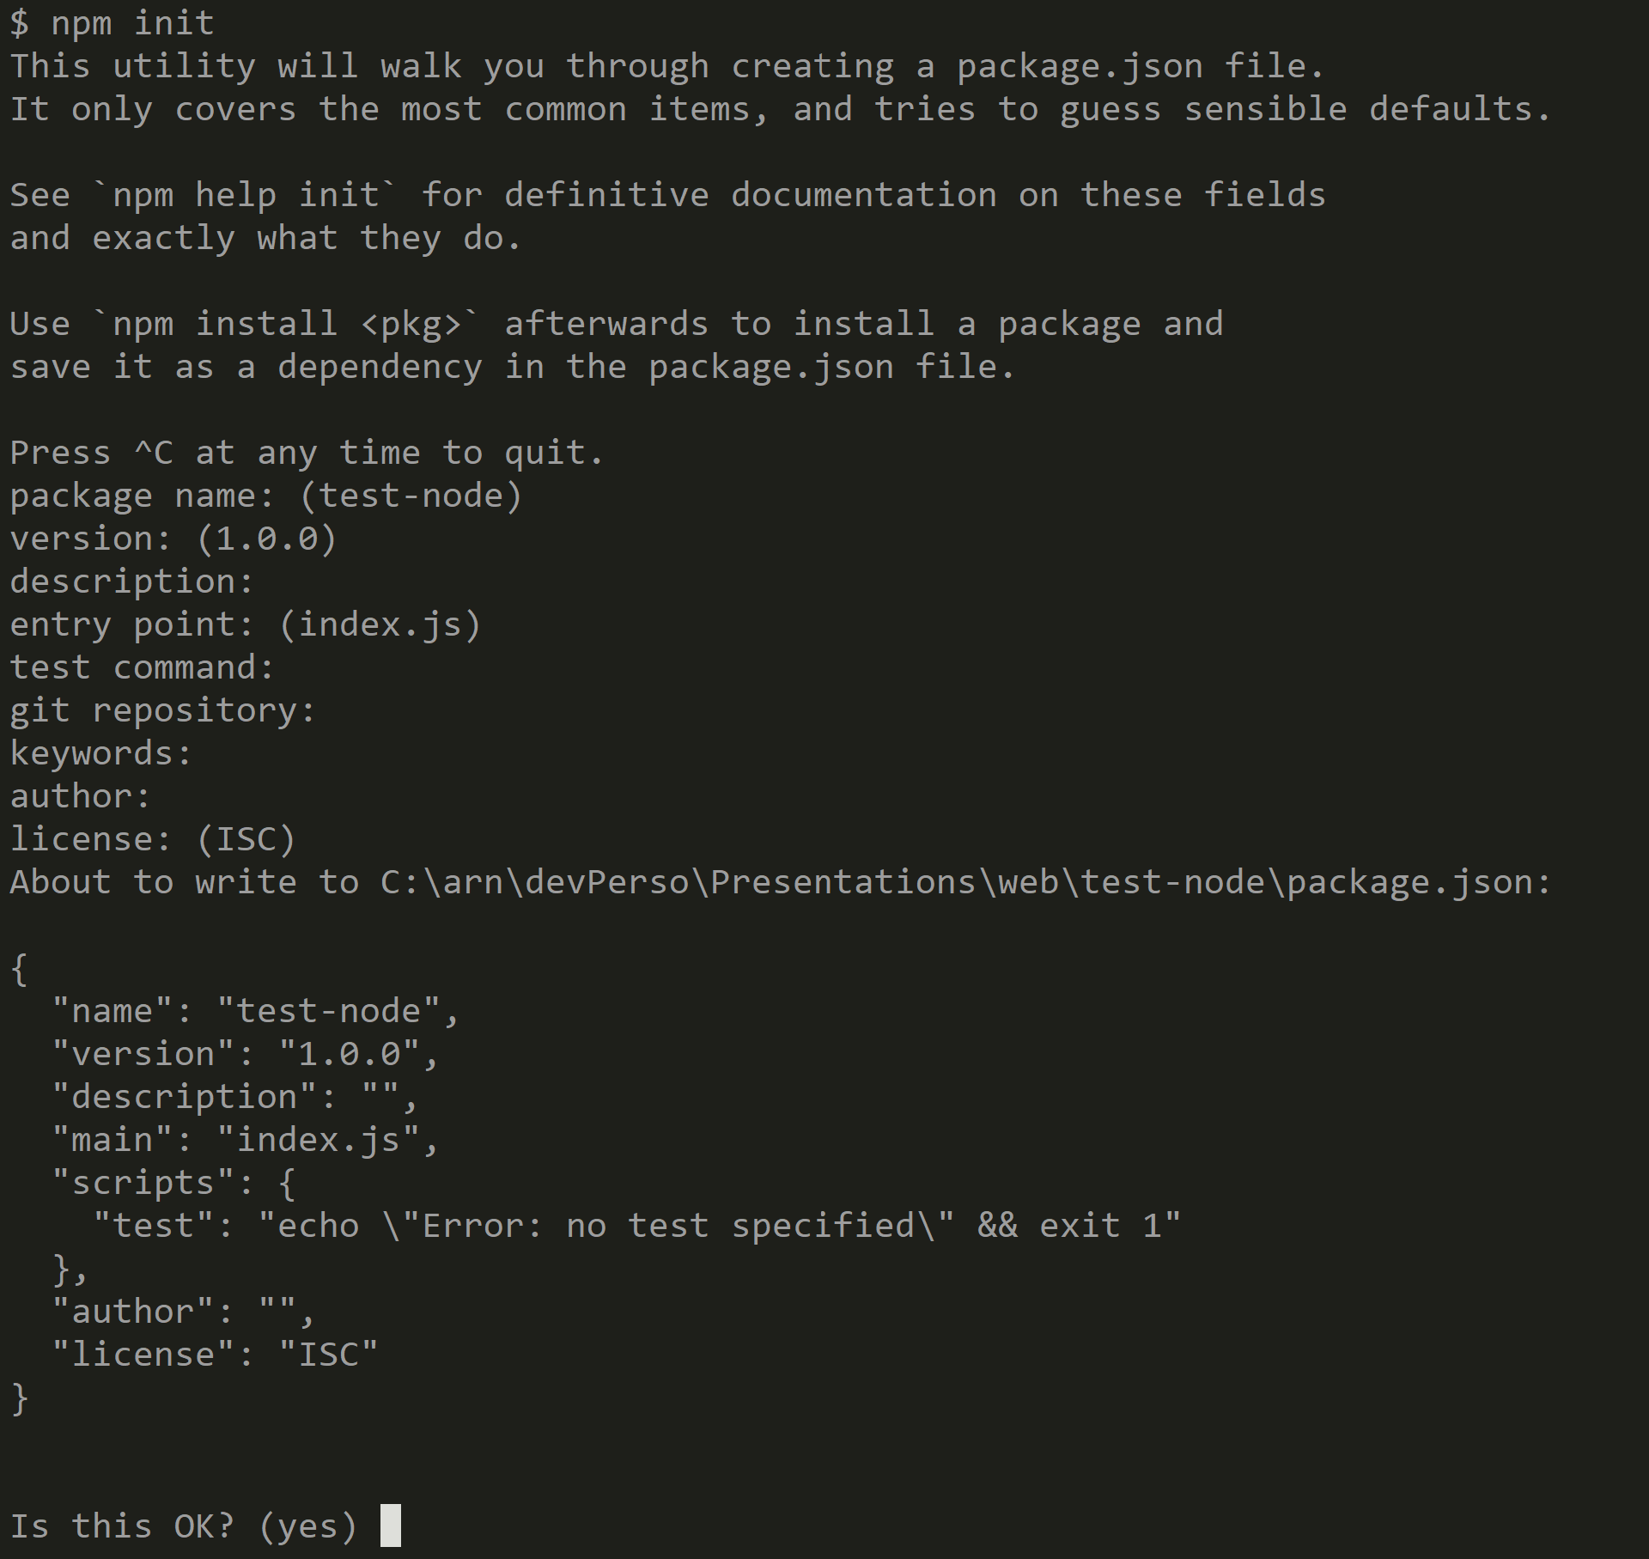
$ npm init

Slide 20
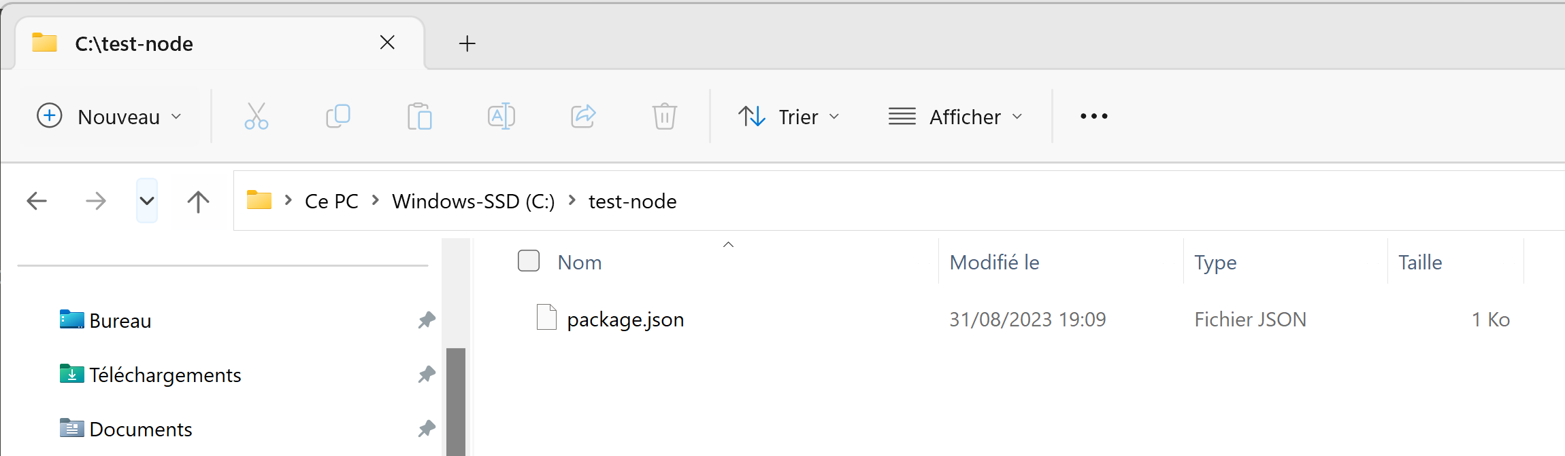
npm init => open File explorer => 1 File « package.json »

Slide 21
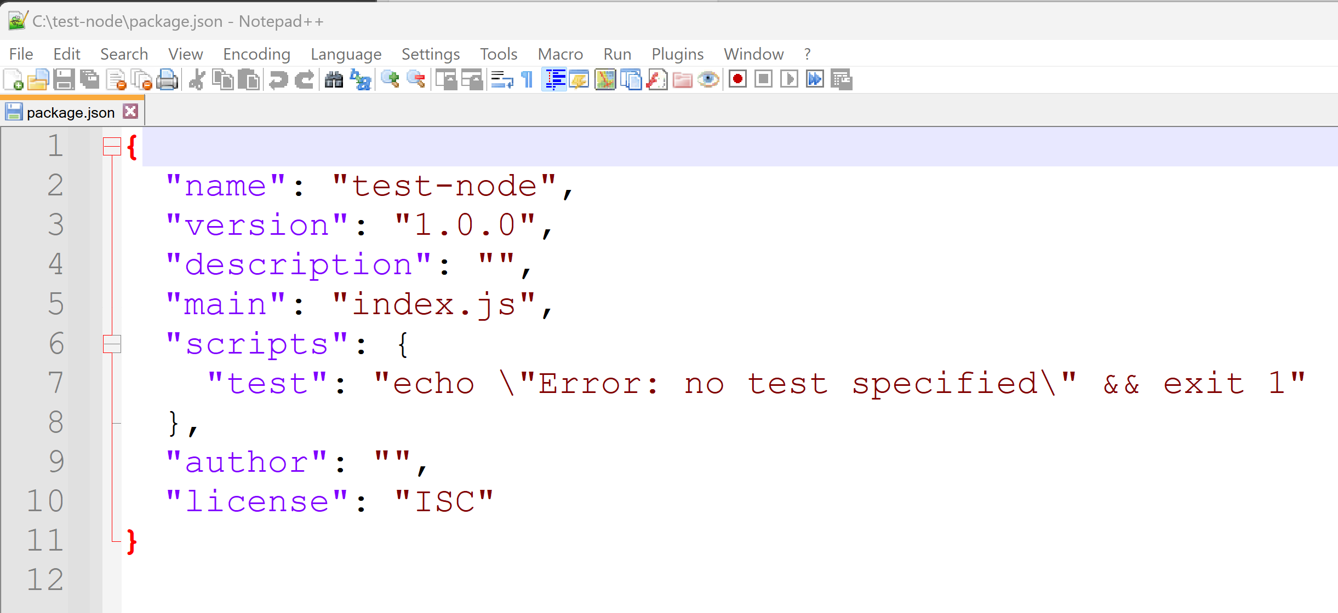
package.json

Slide 22
Search Package dependencies ? ...

Slide 23
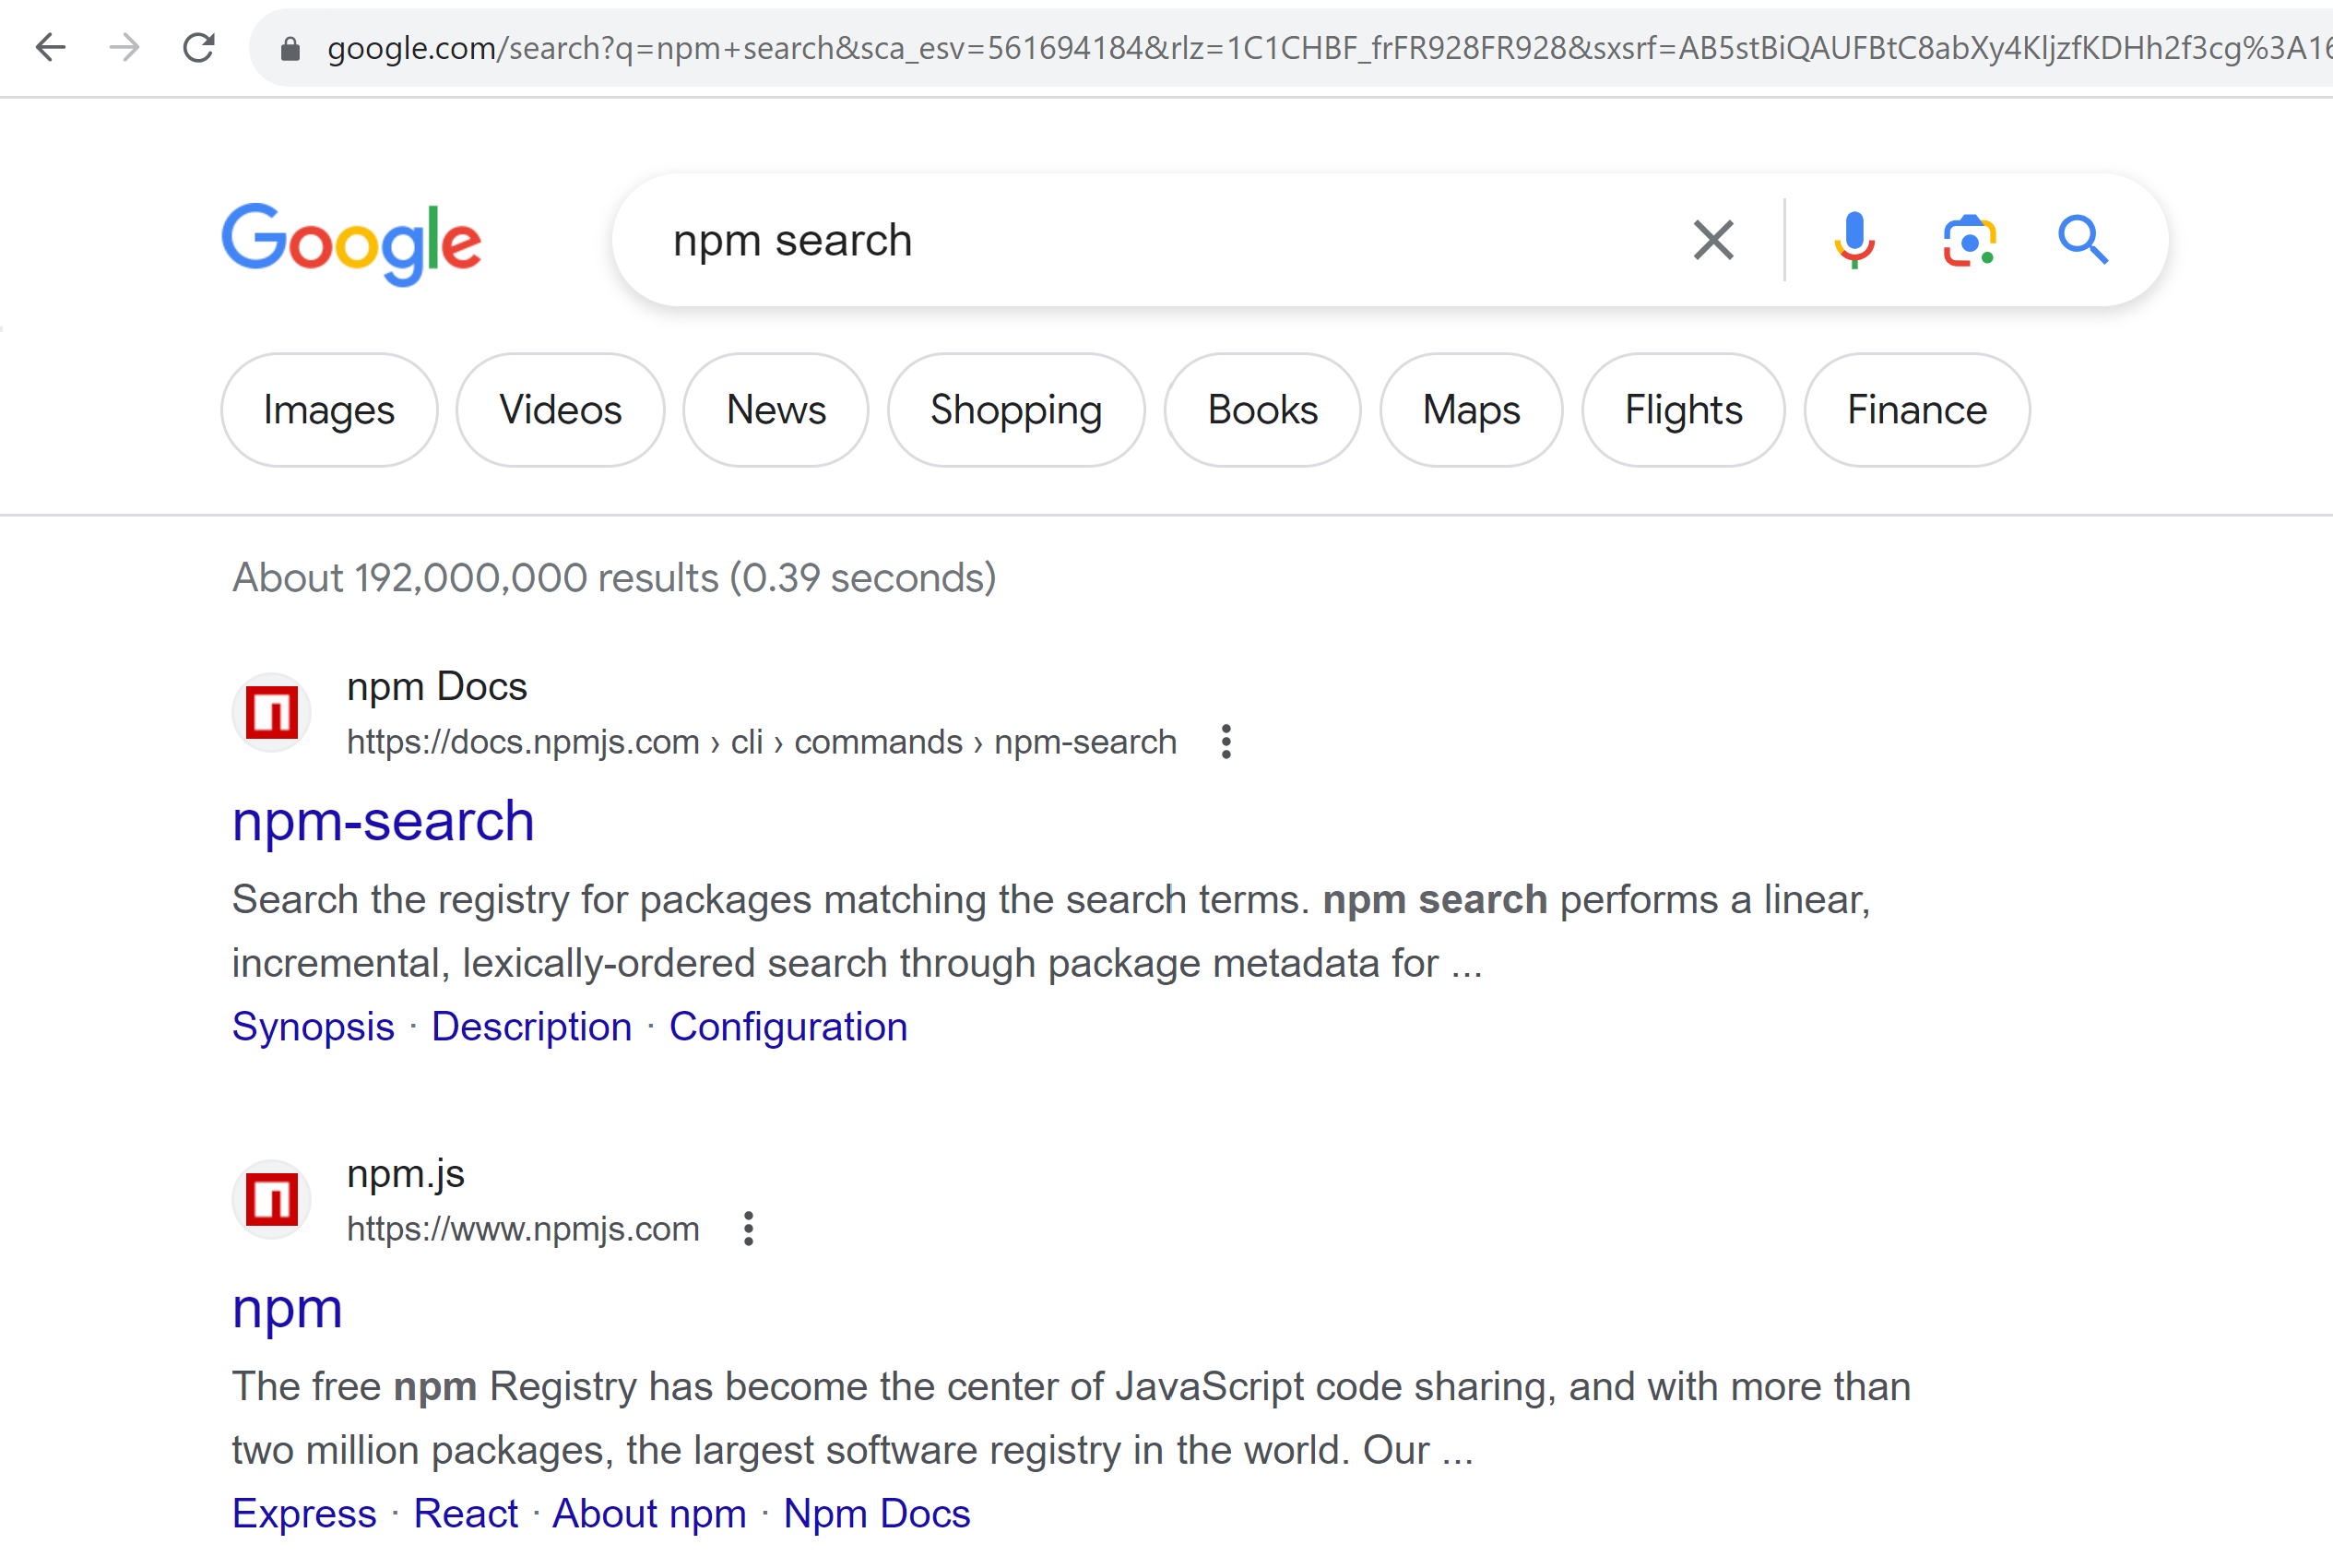
Npm search … Registry (=Repository)

Slide 24
https://npmjs.com

Slide 25
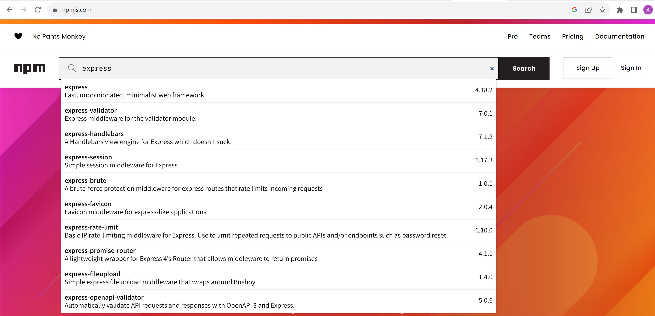
Search « express » package

Slide 26
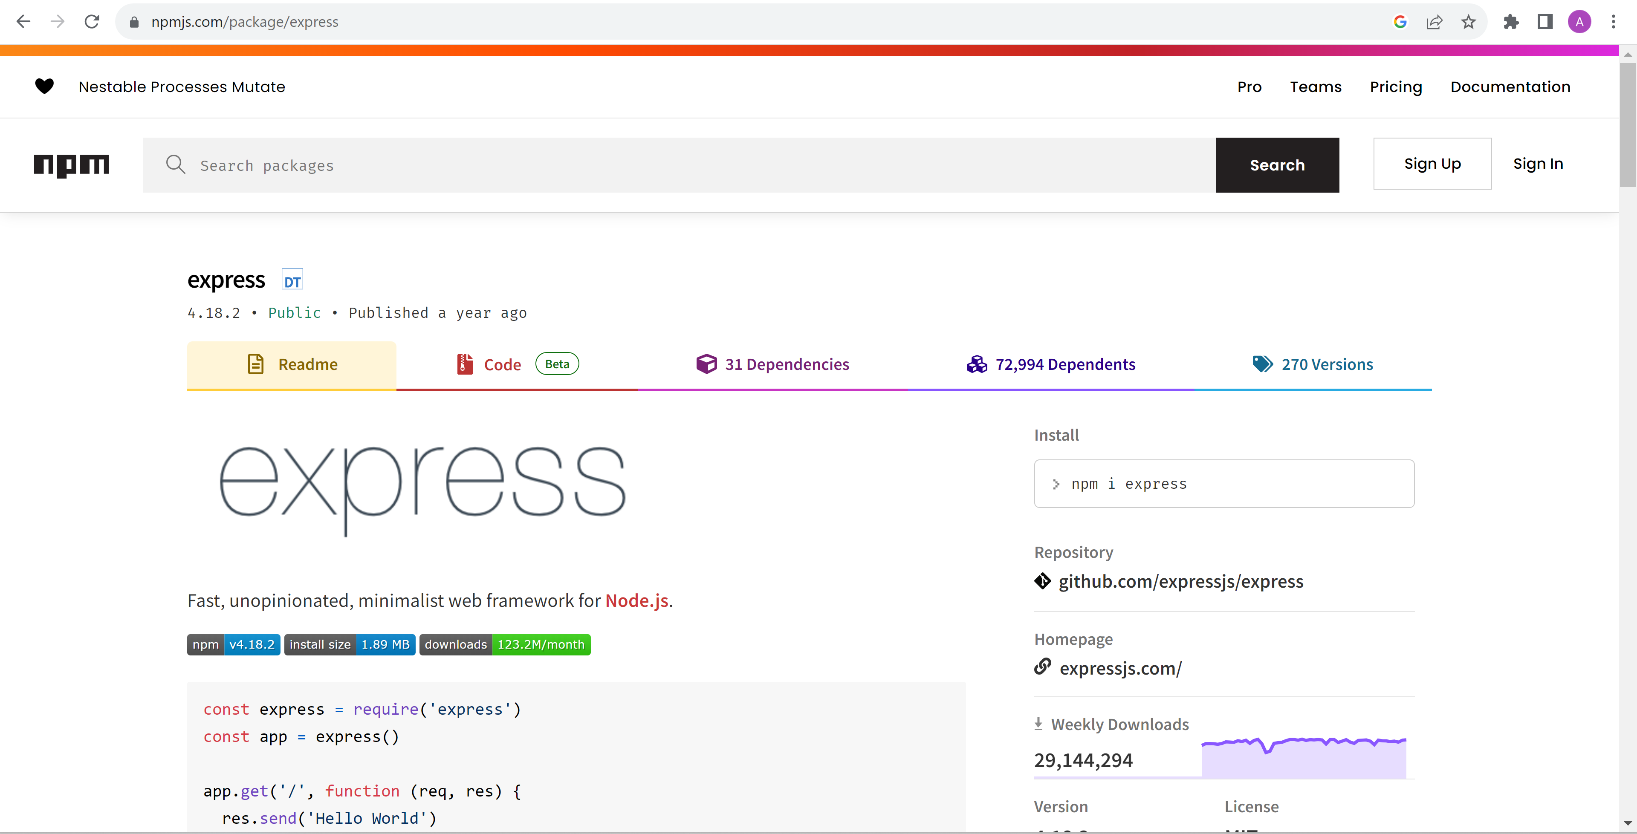
Package express … version / doc / install

Slide 27
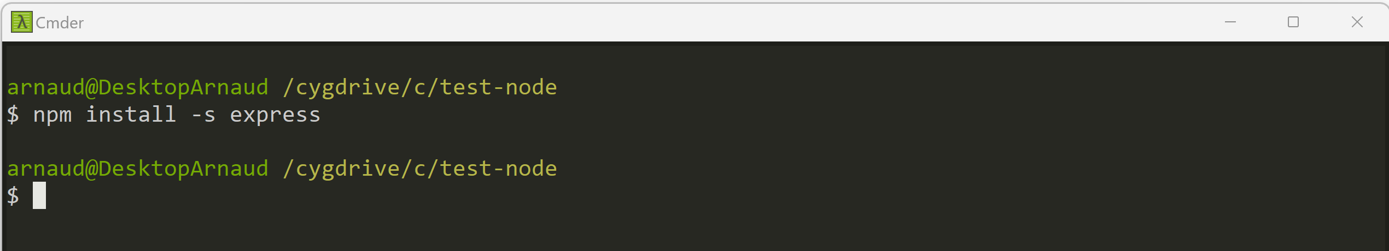
Add npm dependency « express » C:> npm install –s express (equivalent: npm install --save express )

Slide 28
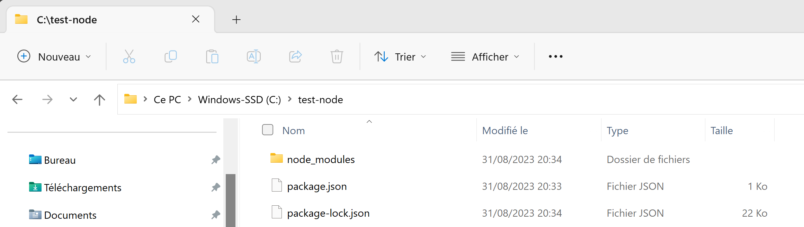
npm --save …. => save to package.json file + package-lock.json + download **/** to node_modules/

Slide 29
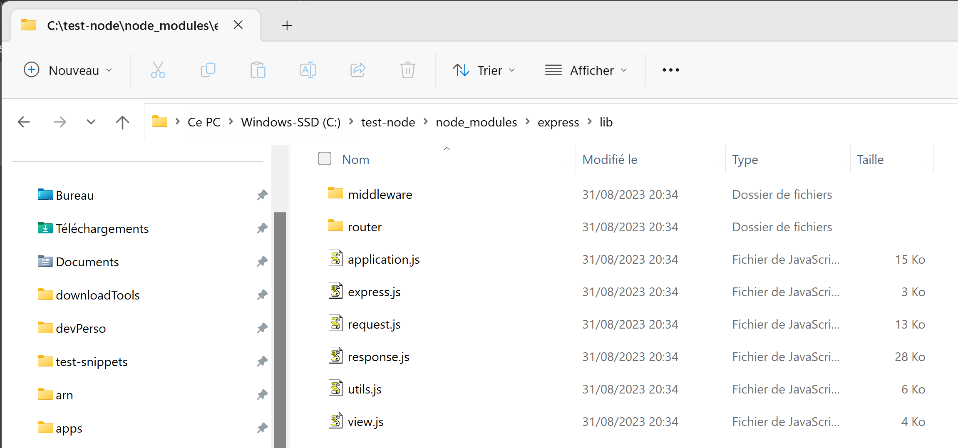
node_modules/express/lib/**/*.js

Slide 30
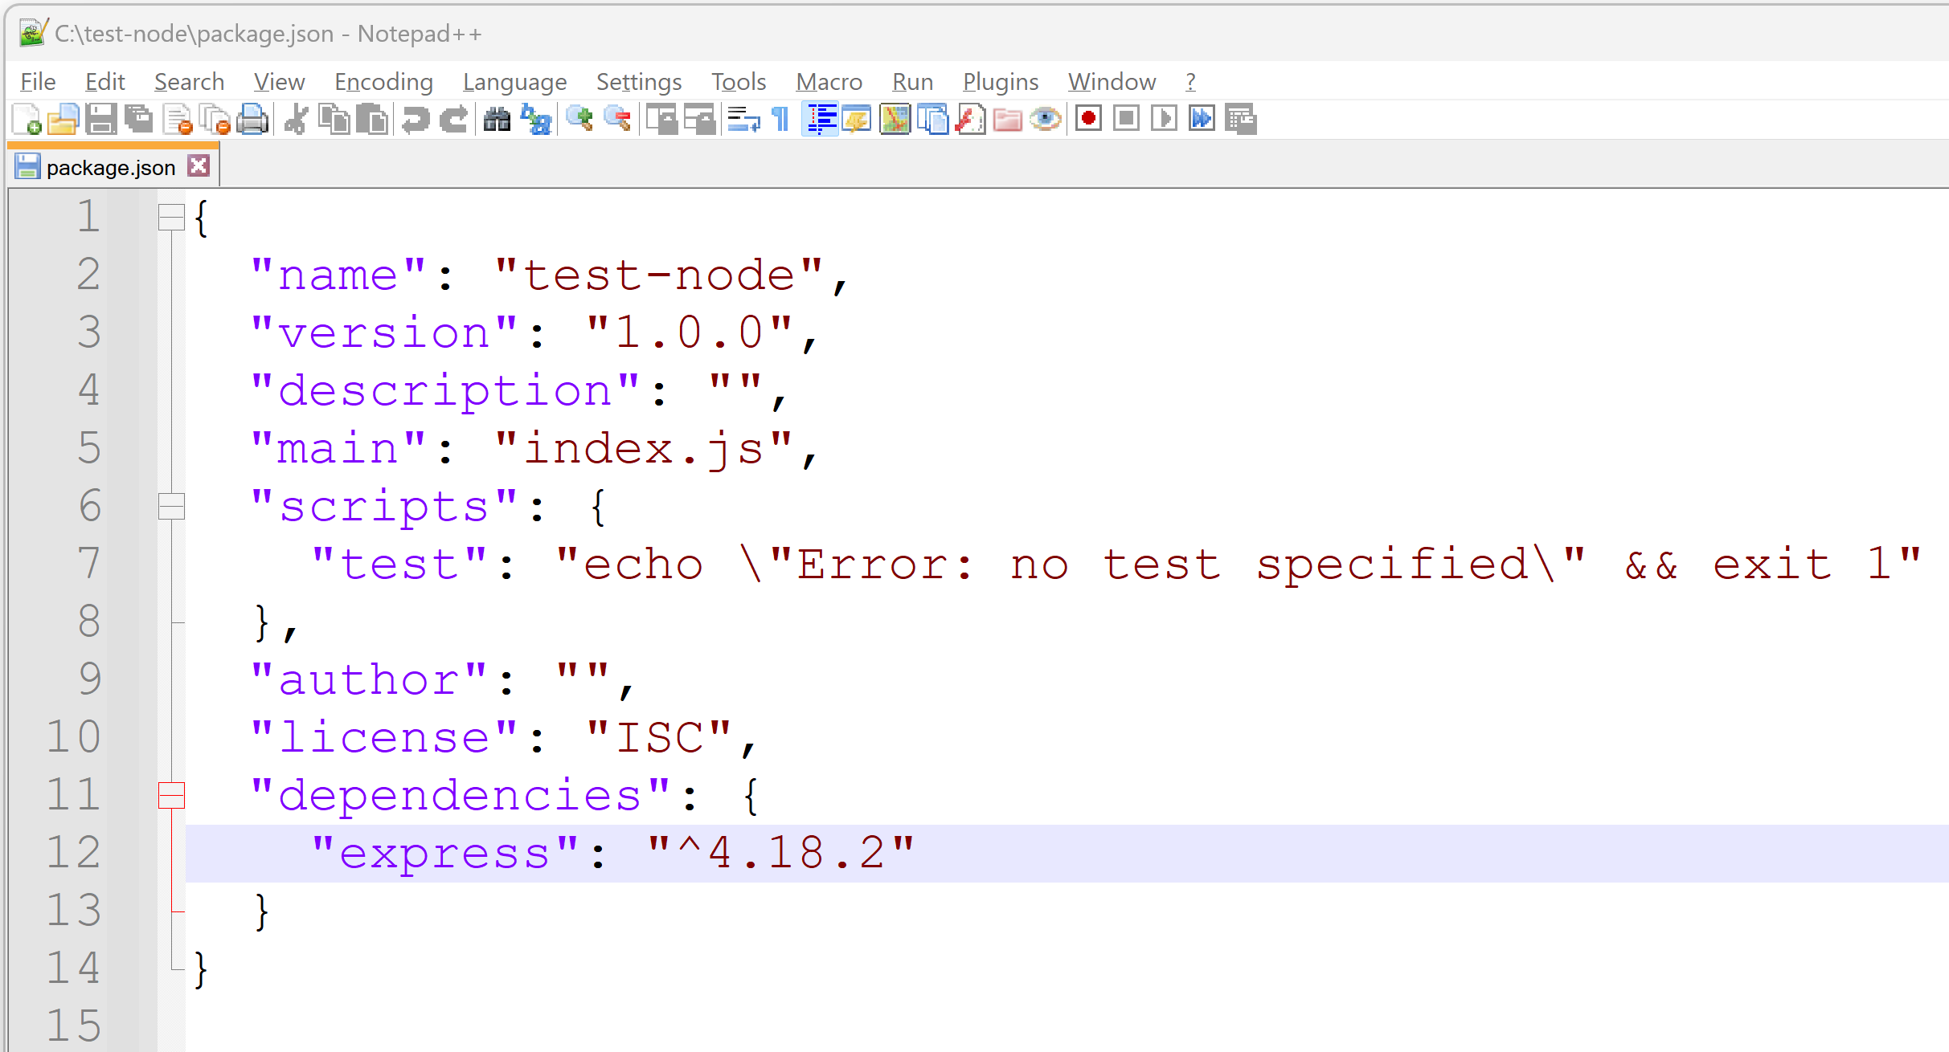
… 1 Line added in package.json dependencies: { «pck-name» : « version », … }

Slide 31
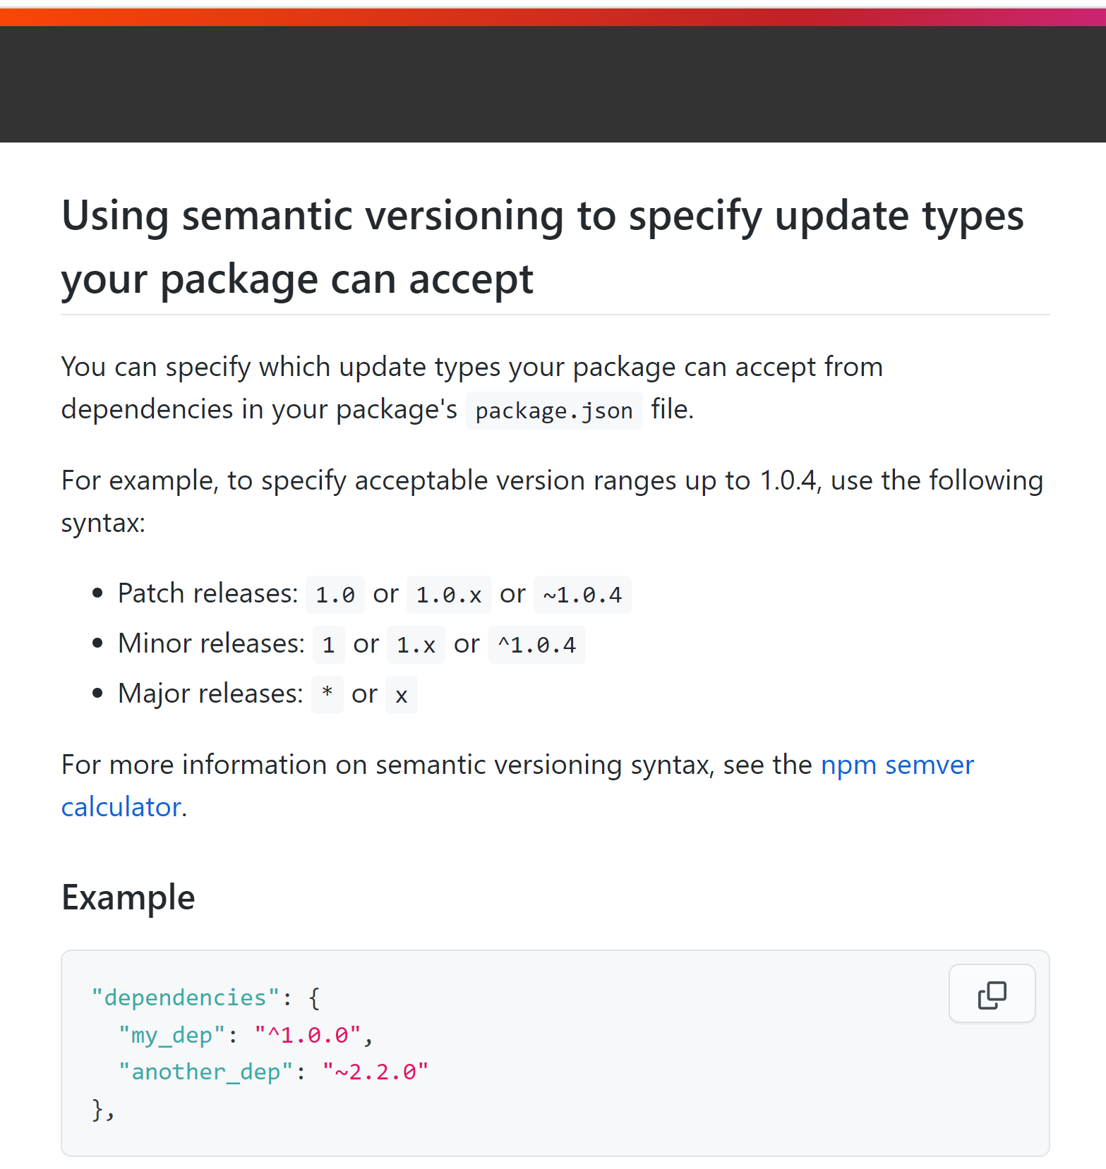
https://docs.npmjs.com/about-semantic-versioning

Slide 32
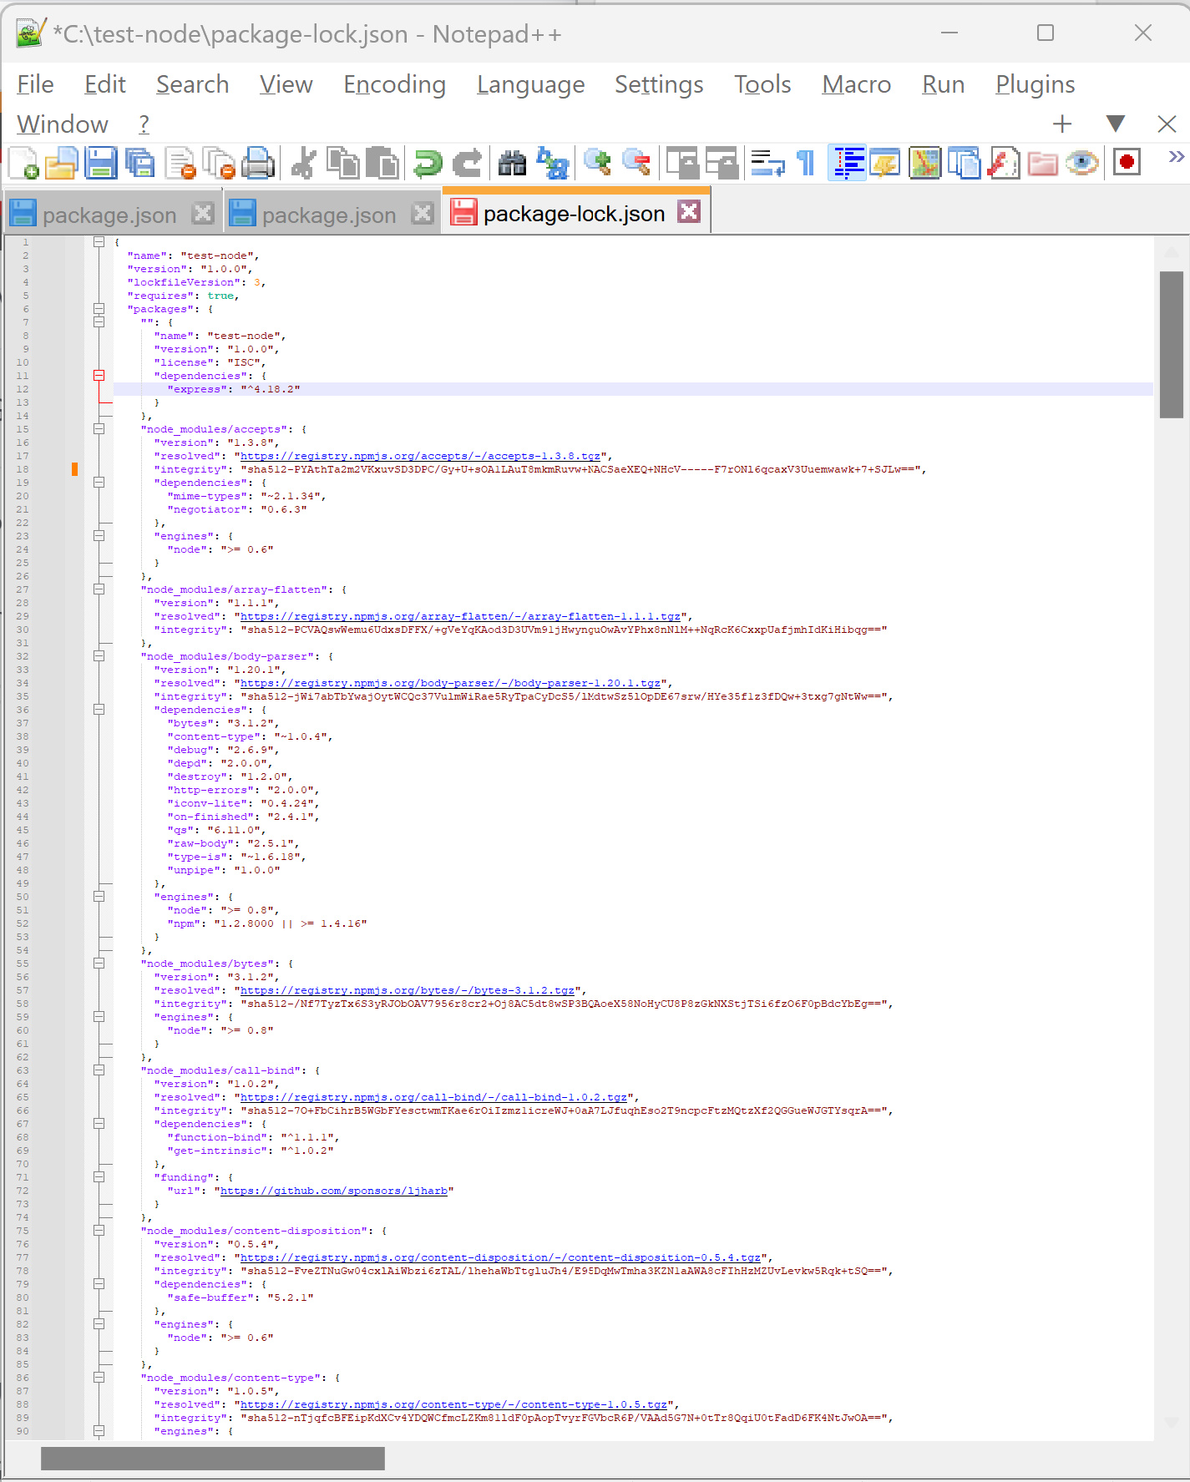
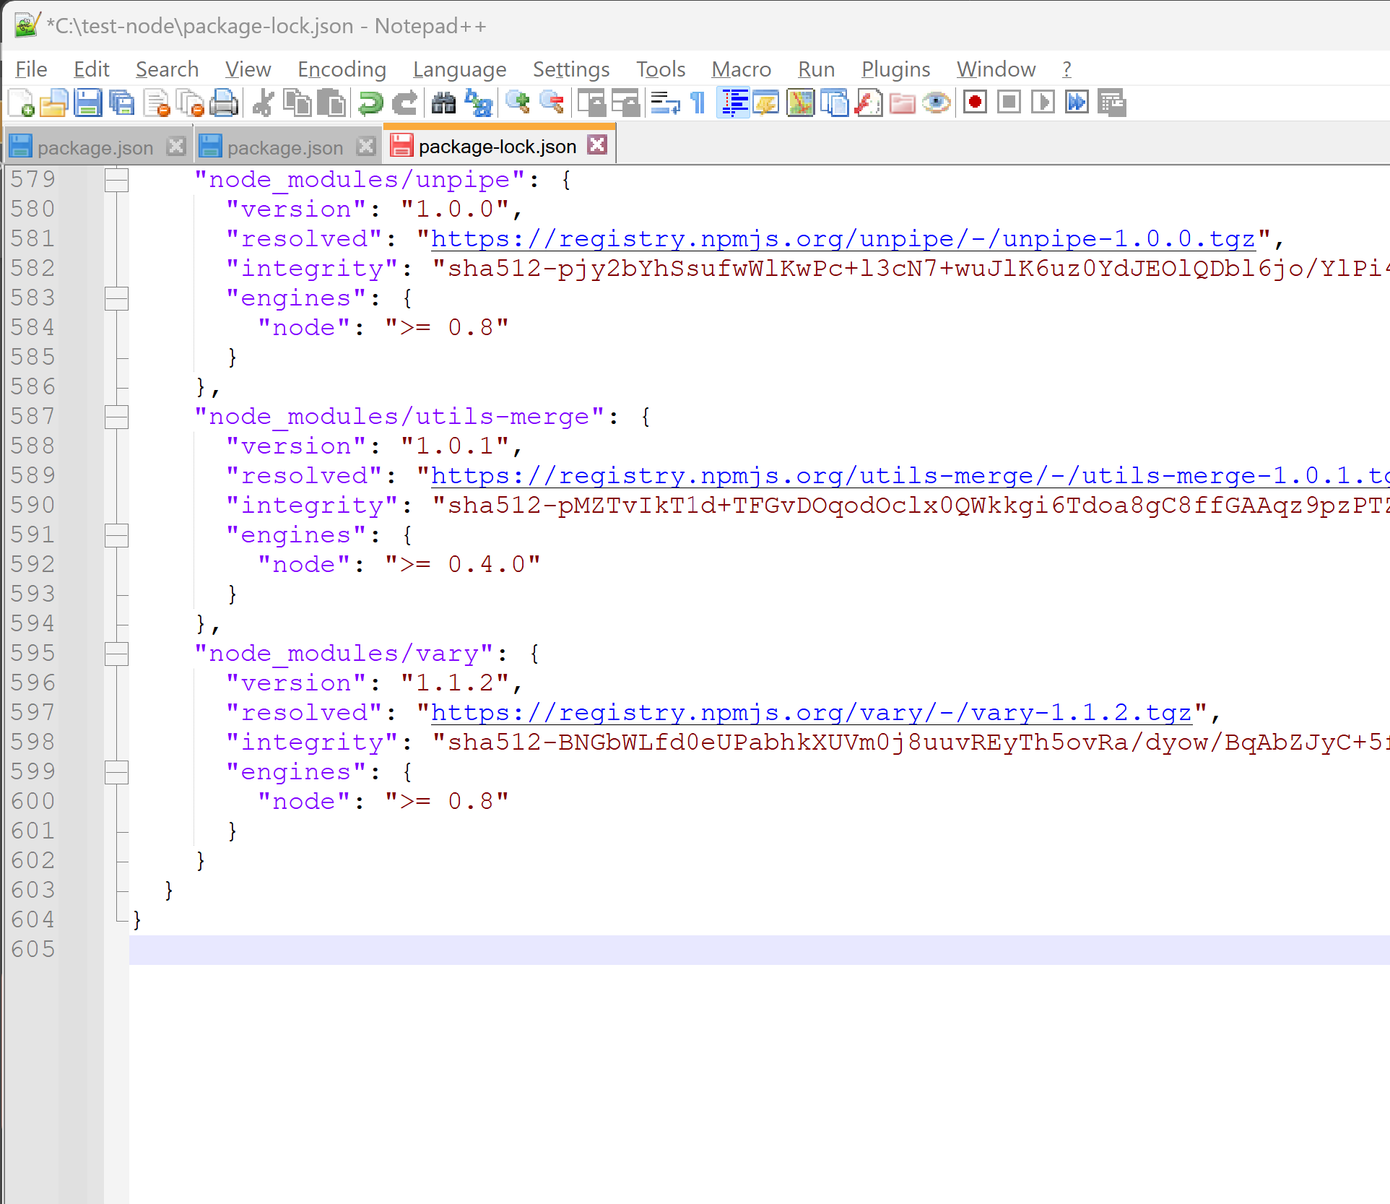
Locking versions number … package-lock.json
File is HUGE …
Like expanded package/package/package !!!
ONLY « express » ➔ 605 lines

Slide 33
node_modules/*/*/*/*.js
Directory node_modules 1/ may be BIG …. ~300 Mega is frequent with few dependencies
$ du -sh node_modules
2/ can be deleted + re-downloaded safely
$ rm –rf node_modules; npm install
3/ should NEVER be committed to any git repository
$ echo node_modules/ >> .gitignore

Slide 34
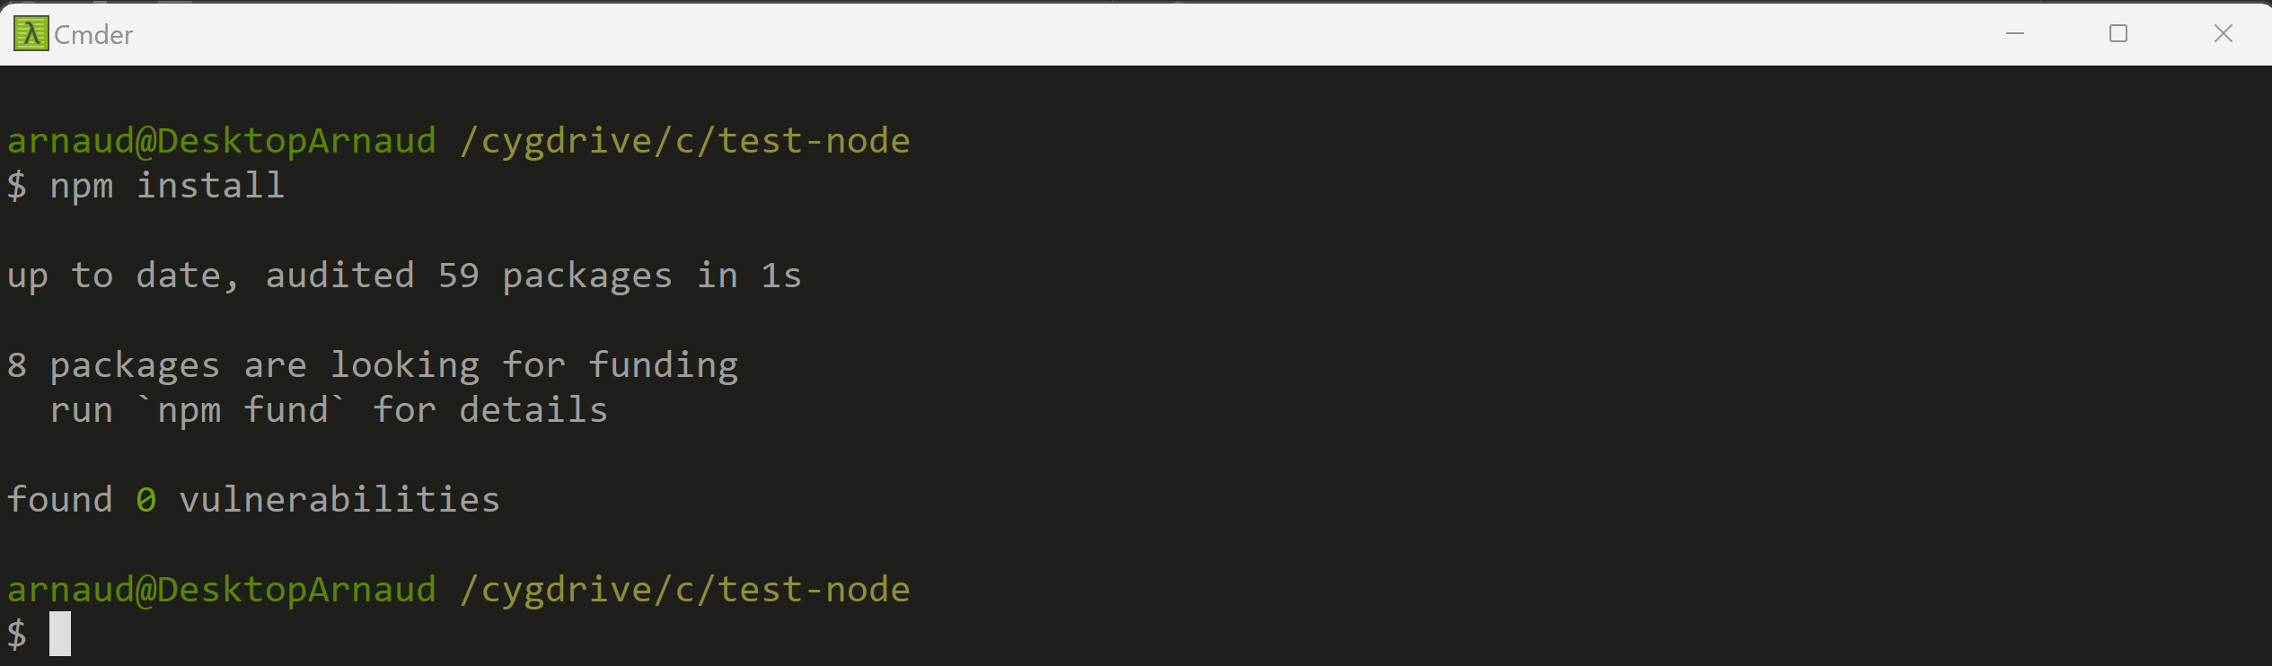
After getting some web project source code… => downloads to re-fill node_modules/** as defined in package.json $ npm install

Slide 35
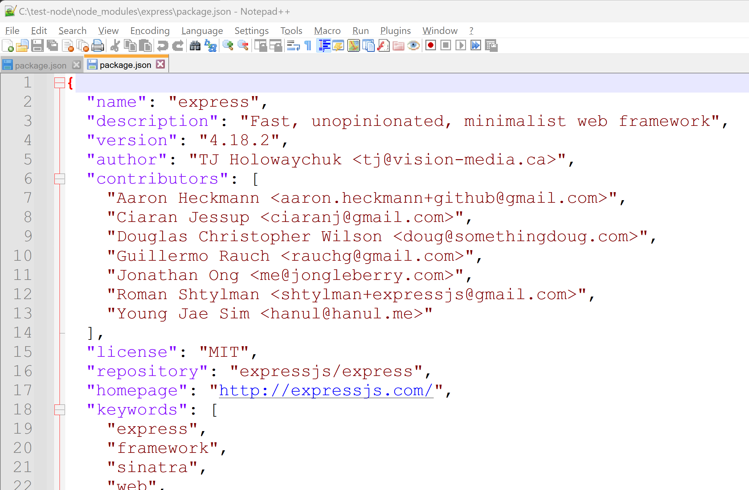
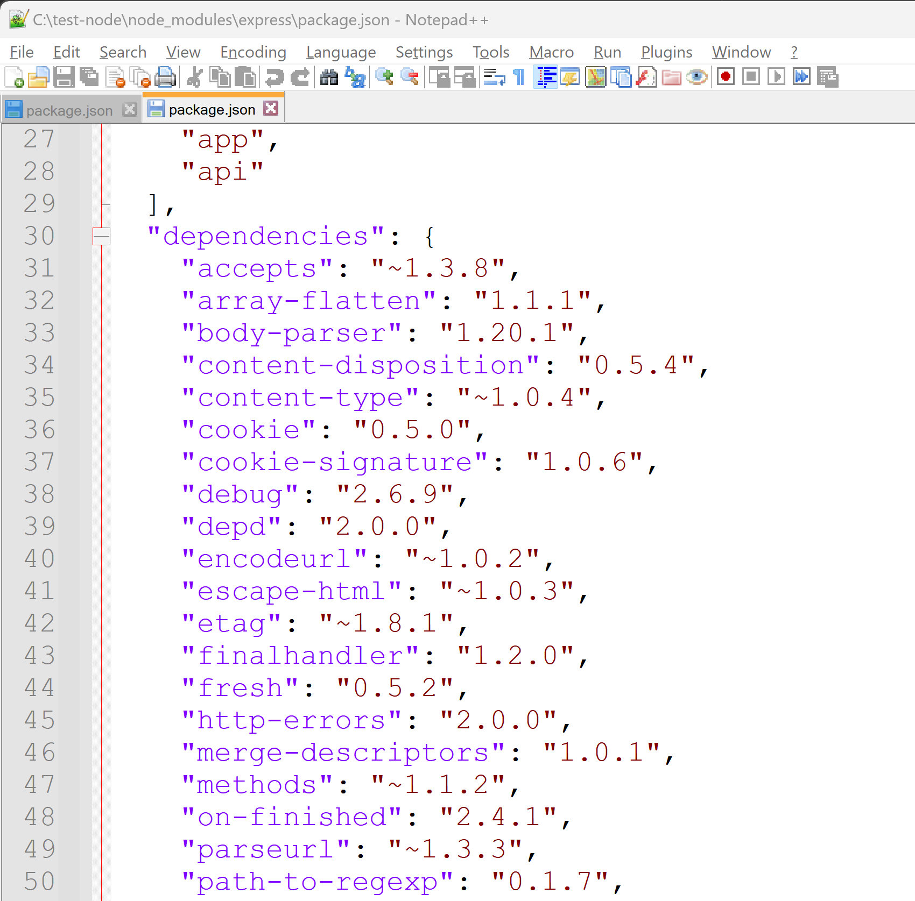
node_modules/express/package.json

Slide 36
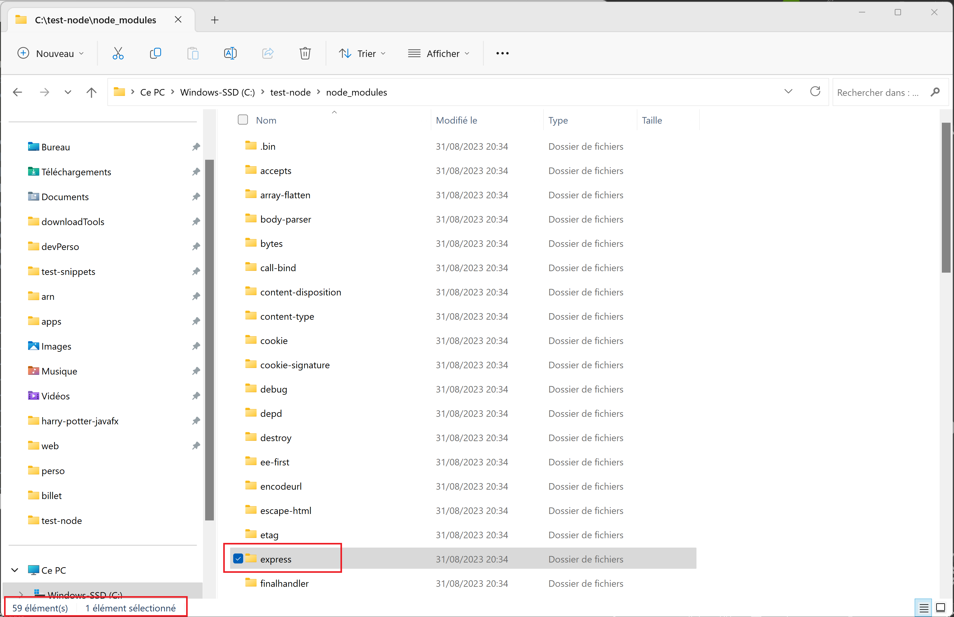
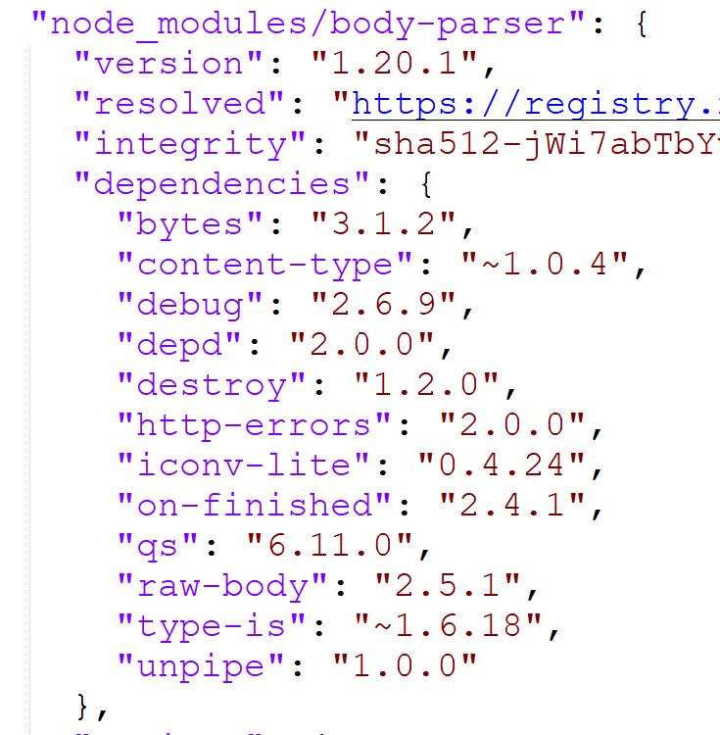
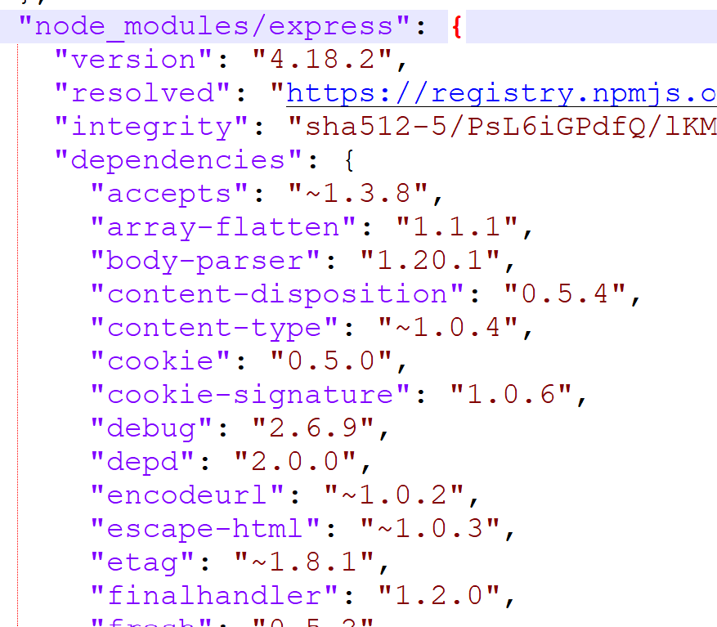
package.json -> package.json -> … package.json transitive dependencies

Slide 37
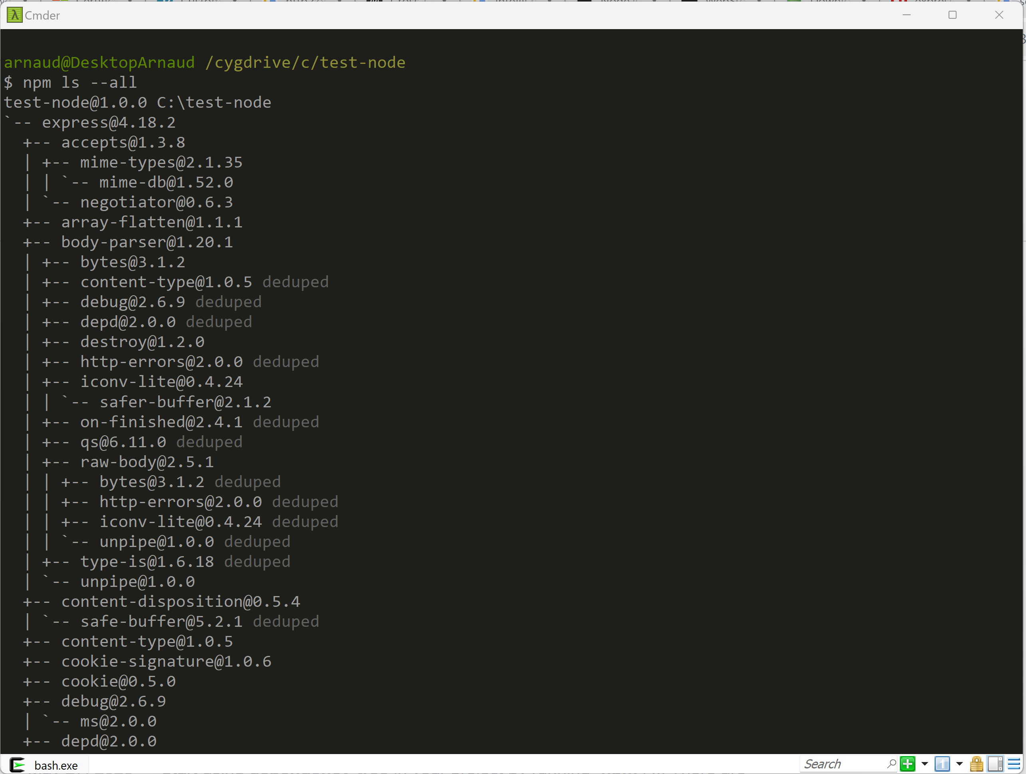
npm ls --all

Slide 38
Coffee break (?)

Slide 39
Choose a Text Editor
IntelliJ Ultimate
Notepad++
WebStorm
SublimeText
Vi
Notepad
VisualStudio Code
Wordpad
Eclipse
NetBeans

Slide 40
Choose (NOT a Text Editor) a modern IDE
IntelliJ Ultimate
€€€$$$ (or 30 days)
WebStorm
€€$$ (or 30 days)
VisualStudio Code
Eclipse + plugins
Eclipse(plugins not pre-installed)
IntelliJ (No web js Support)

Slide 41
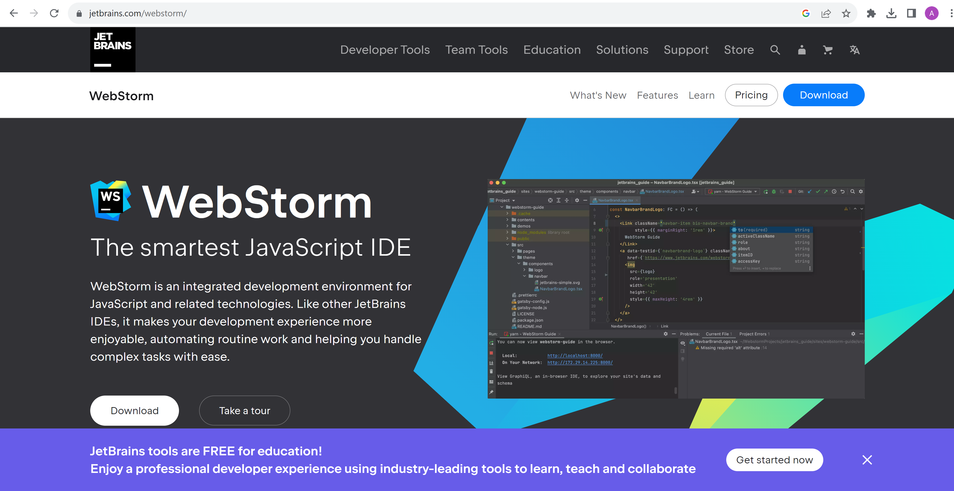
https://www.jetbrains.com/webstorm/

Slide 42
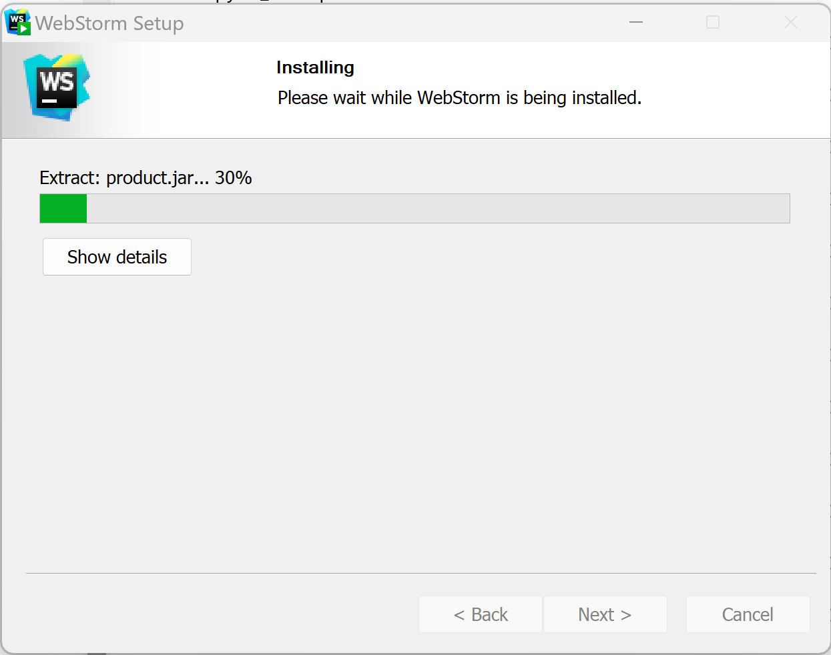
Download 30 days free evaluation + Install …

Slide 43
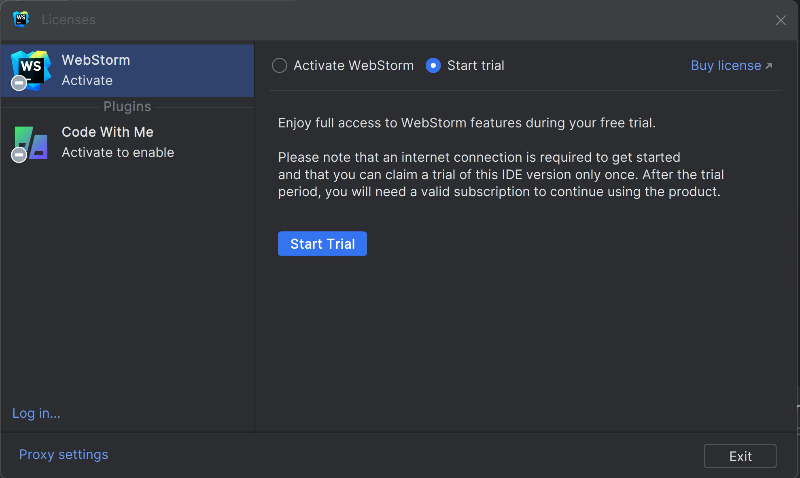
Notice Licenses: IntelliJ Ultimate = WebStorm + IntelliJ + …. IntelliJ Community = .. NO web !

Slide 44
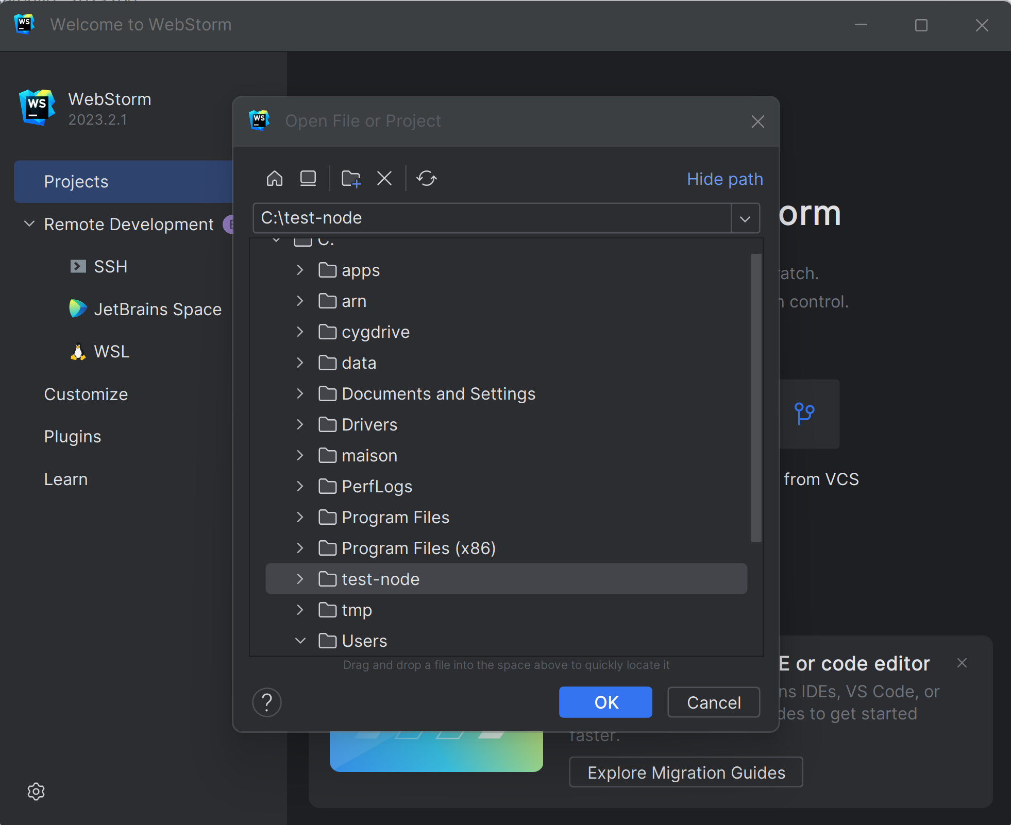
Open Project

Slide 45
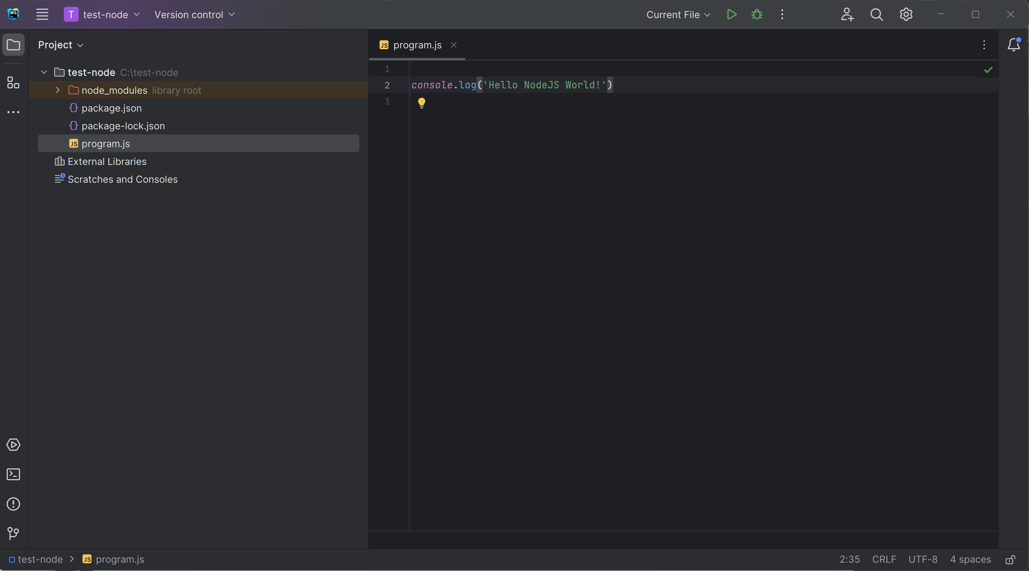
Edit program.js File

Slide 46
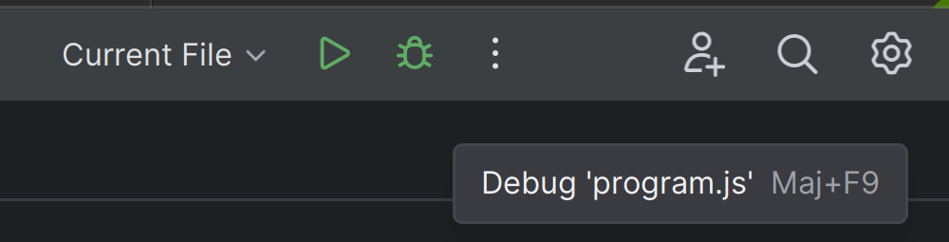

Click on « Run » or « Debug » ?
Debug Mode …. Find the « bug »
Can put breakpoints !
Run Mode ….
Start and forget
Can NOT activate any breakpoint
… can only see logs, and Kill
Why do you use an IDE Debugger
Use directly « C:> node » ??

Slide 47
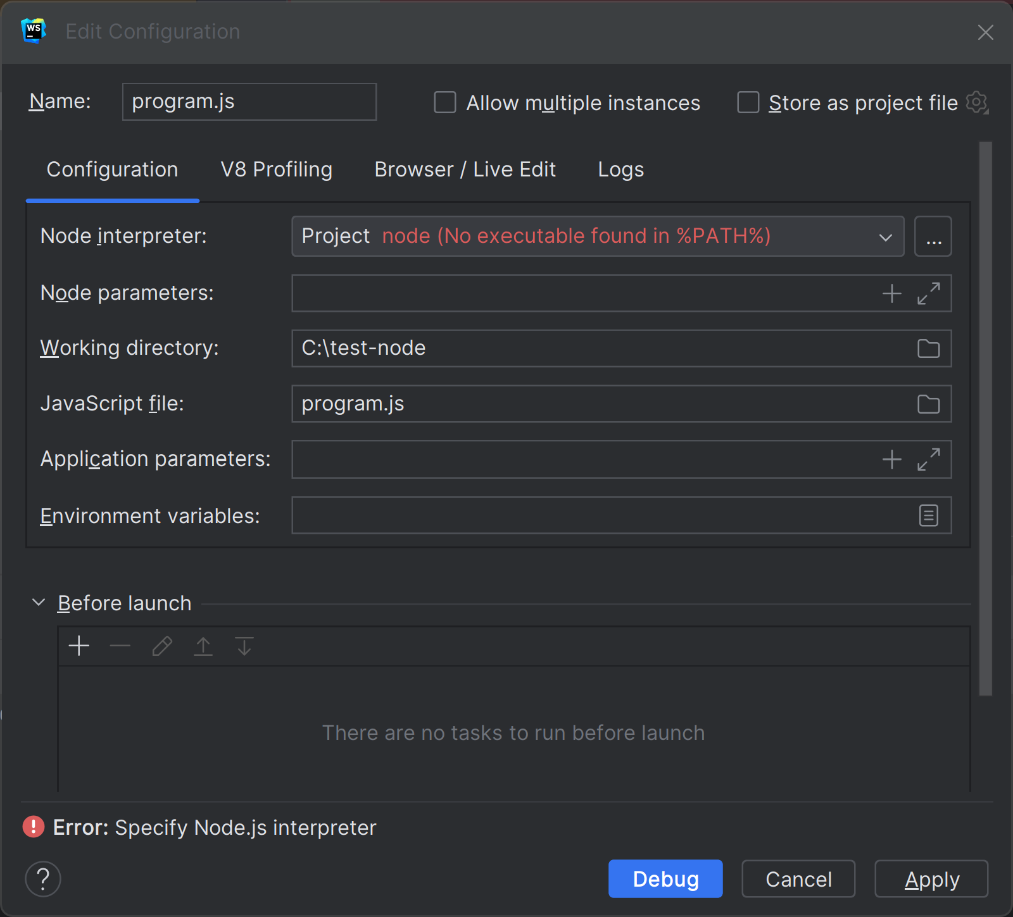
… Case undetected « node » not in %PATH%

Slide 48
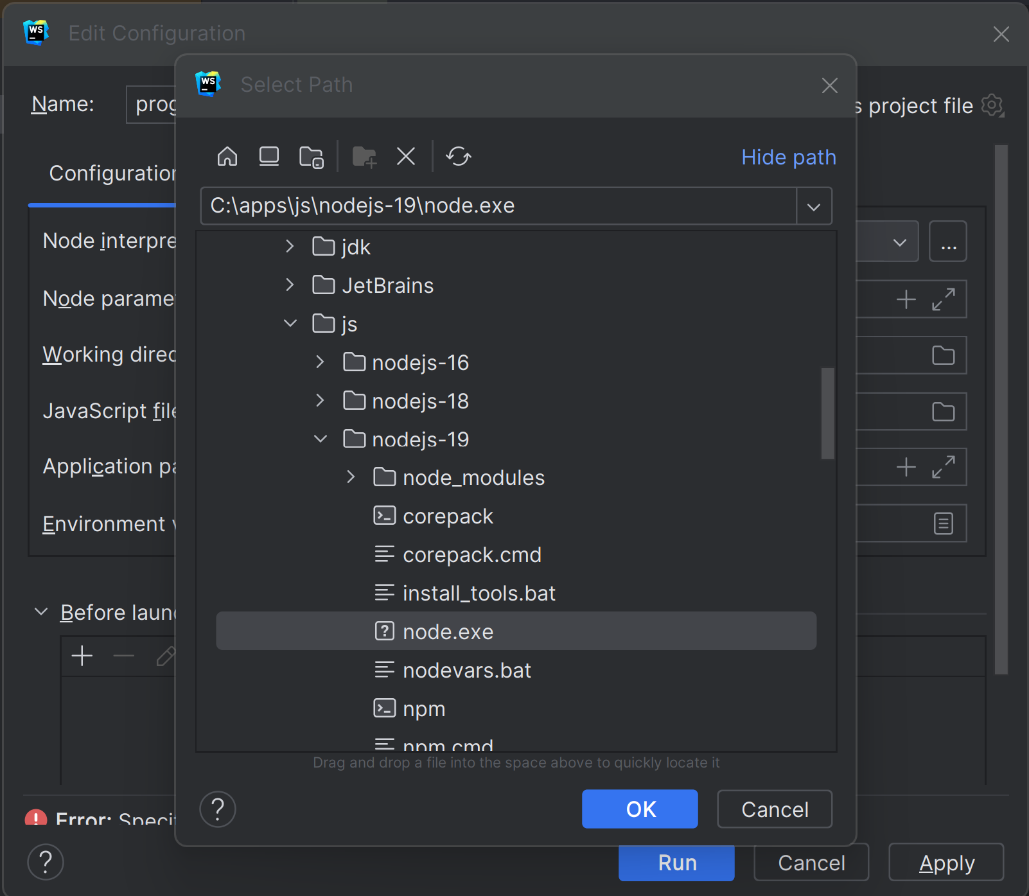
Configure … Add node

Slide 49
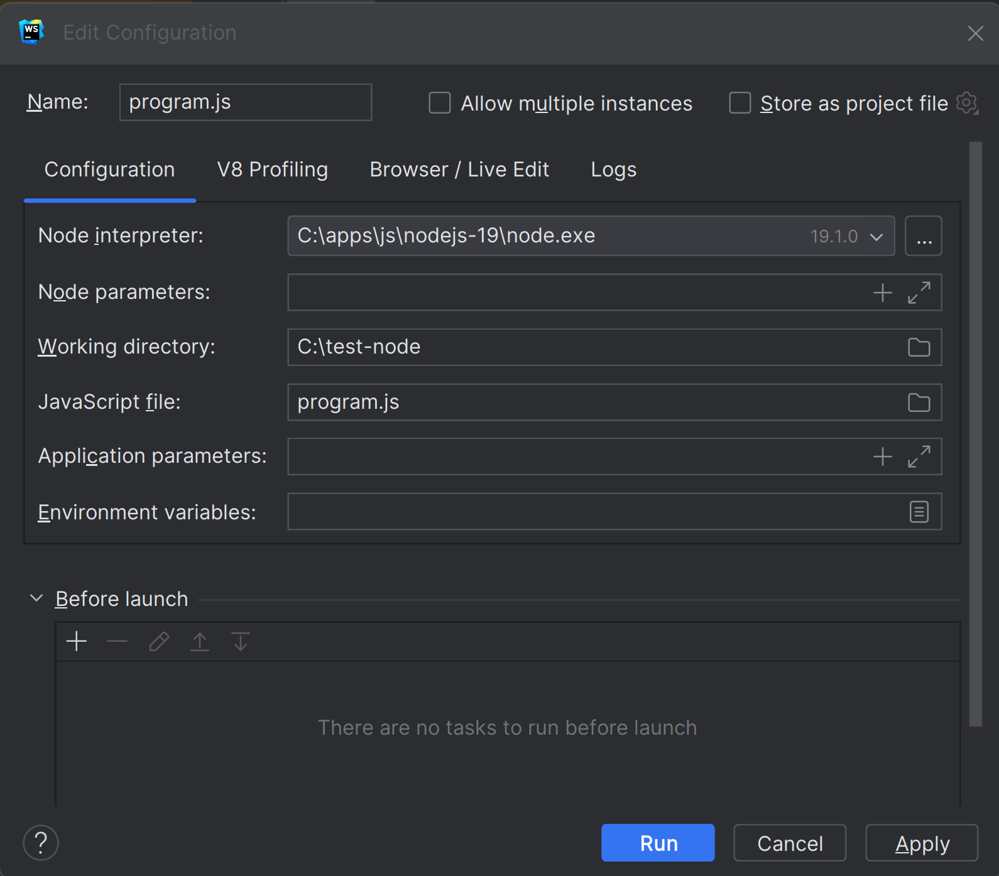
Edit Run/Debug configuration…

Slide 50
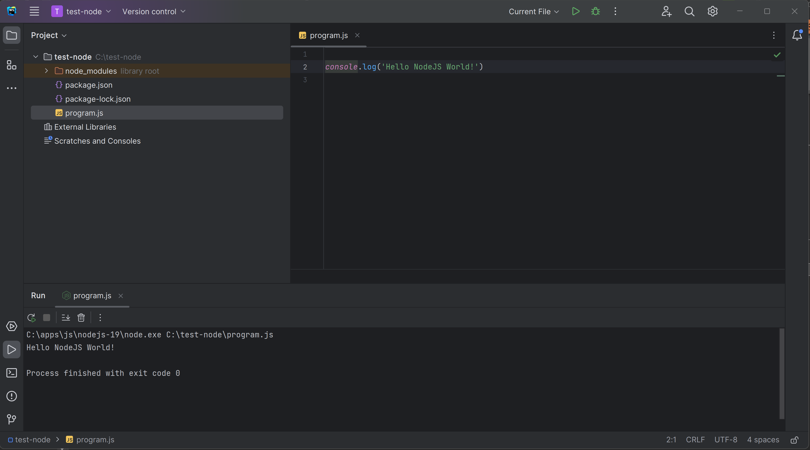
« Run » … Program Finished + console print

Slide 51
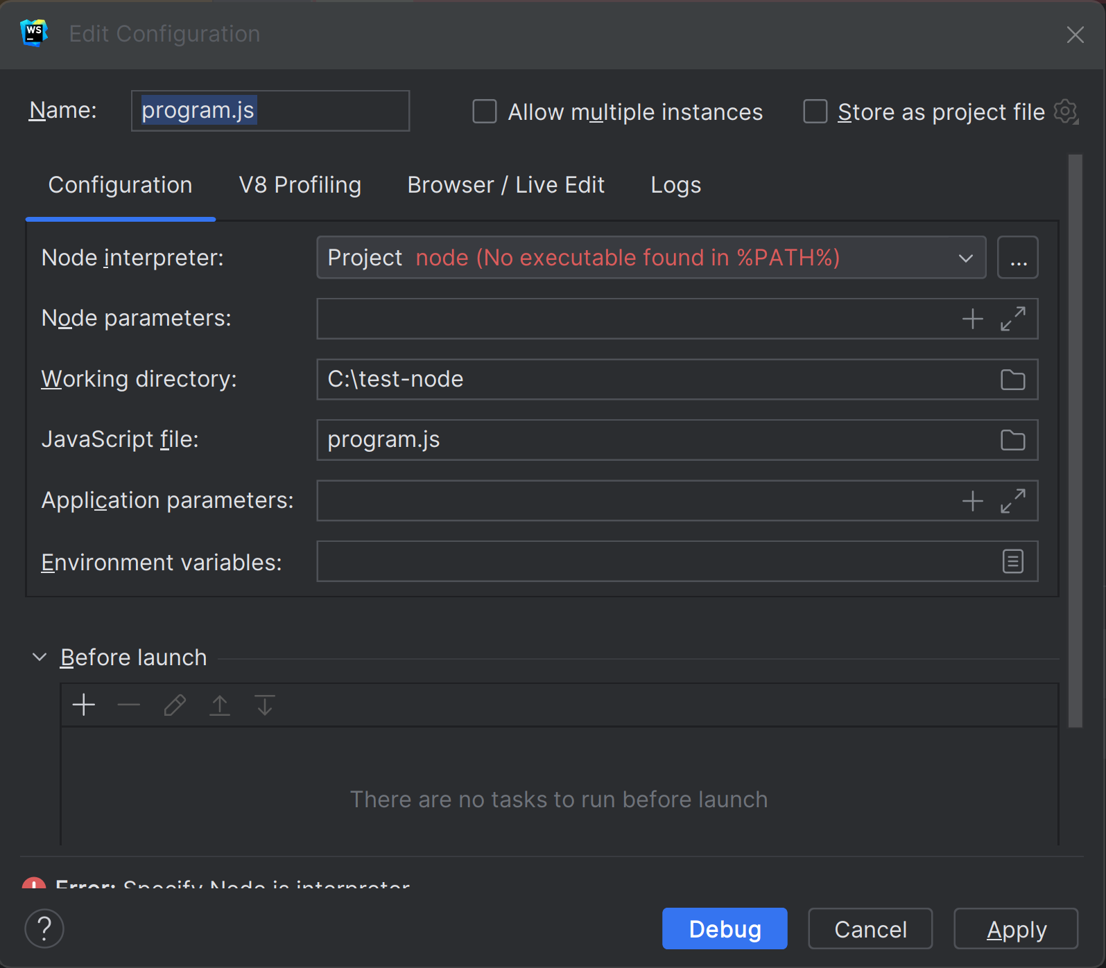
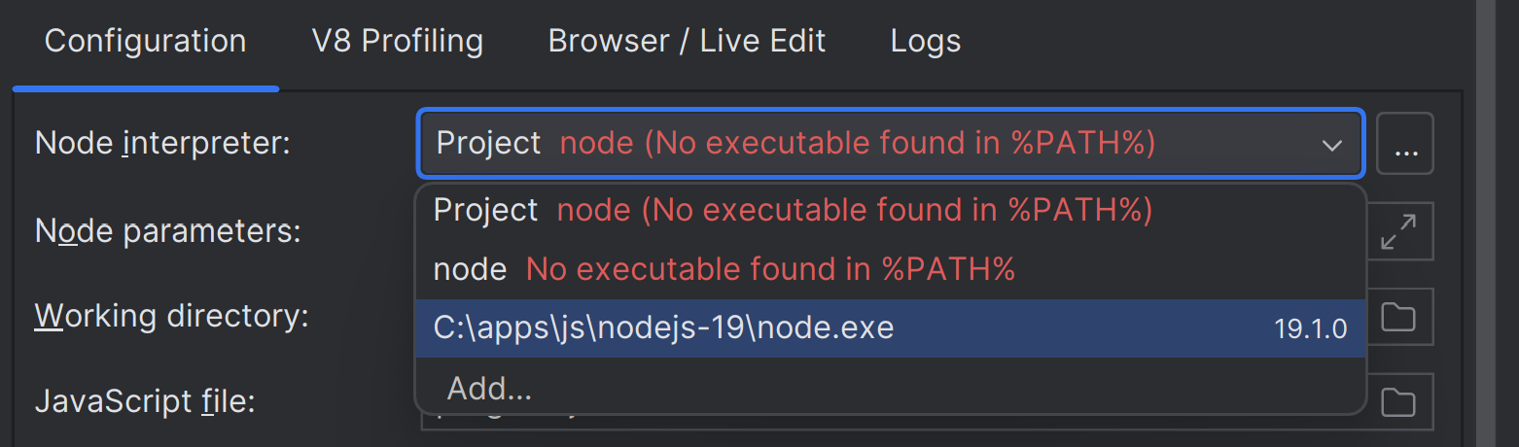
Redo « Run » or « Debug » Need to re-edit node in %PATH% ???
At least, can re-select
already added choice « C:\... » !

Slide 52
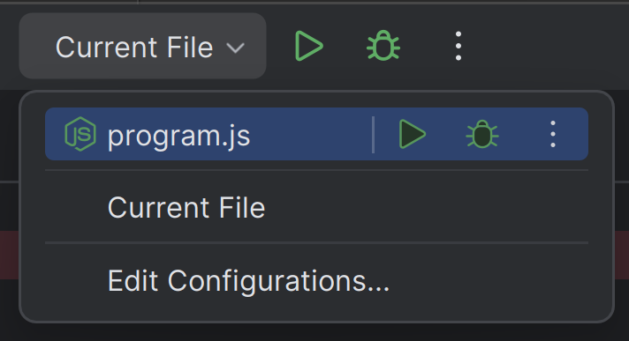
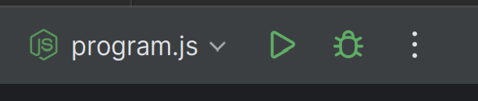
Change configuration « your-config » instead of « Current File »

Slide 53
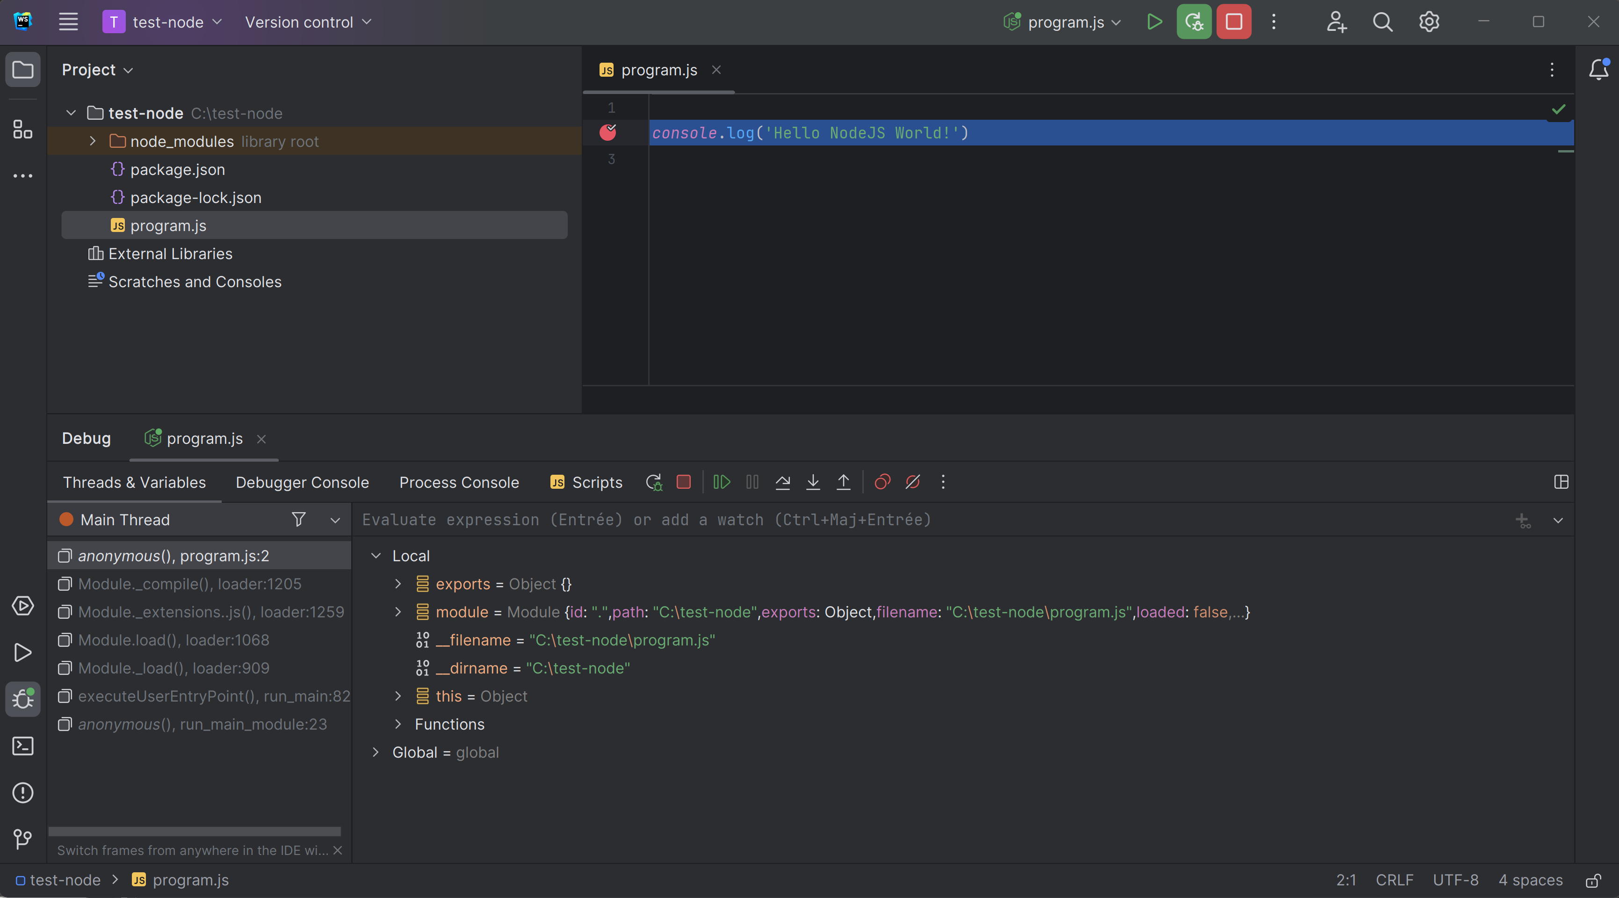
Debug « Mode » + Breakpoint => Program Paused

Slide 54

Step Into(F7) < Step Over(F8) < Step Out (Maj F8) < Resume (F9)

Slide 55
Coffee Break

Slide 56

Complains on JavaScript ?
for Christmas Wish List, ask
Types declarations (standard types, structural types, union types)
Compiled-time Type checking
With Implicit types inference
Object-Oriented Classes
Templates
Spread operators
Syntacic sugars
..

Slide 57




TypeScript

Slide 58

Edit a TypeScript *.ts File

Slide 59

Right Click « Compile TypeScript »

Slide 60

Open Item « .ts » > Sub Item « .js » see generated Js !!

Slide 61

Debug Ts program … (No Run/Debug/breakpoint in *.ts, but ok in *.js) need « .map » file for mapping ts line X <-> js line Y

Slide 62

Edit Settings > TypeScript > Recompile on changes

Slide 63

Edit on Left *.ts … see real time change in right *.js

Slide 64



Edit many **/*.ts … see corresponding **/*.js
Expand views
Check on FileSystem

Slide 65
tsc = TypeScript Compiler … same as in IDE, but in batch mode, for CI-CD
tsc is internally used by WebStorm
… / IntelliJ / VisualStudio Code / Eclipse !!
tsc even generalised it as « langage server »
=> You have exact same compilation in all IDEs !!

Slide 66

https://www.typescriptlang.org/docs/handbook/typescript-tooling-in-5-minutes.html

Slide 67

$ npm install –g typescript ( « -g » for « --global » … add tsc in node %PATH%)

Slide 68

$ tsc

Slide 69
3 uses cases … 1/ compile 1 single .ts file 2/ compile **/*.ts in project 3/ « -w » real-time watch to recompile on change

Slide 70

$ tsc single-file.ts

Slide 71

Tsc Compiles … find ERRORs messages at compile-time Compare… remember typo found at runtime ? https://my-broken-web-site-deployed-in-PROD.html

Slide 72

Create tsc configuration file: « tsconfig.json »

Slide 73

Default tsconfig.json

Slide 74

Notice sourceMap:true in tsconfig.json … and **/*.js.map files generated

Slide 75

.map file … = « lineNumber » debugging info between source « *.ts » and generated « *.js » Analogy with java: between source « *.java » and generated « *.class »

Slide 76
Remark and Analogy
JavaScript is the « low-level » assembler langage (~x64) on the Web
Supported by all « web browsers » AND « node » (~intel/amd processors)
No developper code anymore in assembly langage directly
(they prefer high-level C, C++, Java, C#, Python, …)
Web developper prefers TypeScript rather than Js directly ..

Slide 77
Remark of The Remark … WebAssembly
JavaScript is such an horrible monster langage
(with eval and strange permissive things)
W3c standard « WebAssembly » use only a SUBSET of JS
… that can be really statically typed / analysed / understood
then transformed to native x64 code by « compiler »
« WebAssembly » is trully a fast assembly langage
almost as fast as optimised « normal » code

Slide 78

.map Goodies … can put breakpoint on *.ts (still debugging *.js for launch)

Slide 79

$ tsc ( or equivalent : $ tsc –p tsconfig.json )
Case when error…
Case when OK…
NO log !!

Slide 80

$ tsc -w
Case when OK…
NO log
Case when error… cf next slide

Slide 81


Edit file to get Compile Error with –w (watch)

Slide 82

Install « typescript » in package.json devDependencies (devDependencies != dependencies, != global ) $ npm install –save-dev typescript

Slide 83

devDependencies…

Slide 84


Edit package.json « scripts »
« $ npm run compile-typescript »
… is equivalent to « $ tsc »
« $ npm run build »
… is equivalent to « $ tsc -w »
Notice:
There are Run icons for each script line

Slide 85
Understanding Angular « ng » client internals
« npm run start»
Internally Call
Internally Call
« ng serve »
« tsc -w»
Compile all *.ts to *.js
(maybe webpack all into a single app.js )
Internall call « node » with express server
… http server running on port « http://localhost:4200 »
All commands « npm », « ng », « tsc »
Run internally « node » !!!
Also Use « live-reload.js » …
so Web browser automatically refresh page on change

Slide 86
Coffe Break / Lunch Break (?)

Slide 87
Next Steps…

